Slide 1

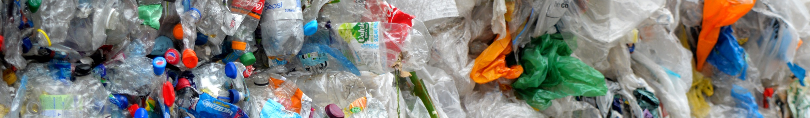

Together, we can make plastic pollution a thing of the past.
Notes:
Start by introducing yourself; your name, where you work and what you do. You can then lead in to.. Today I am going to talk to you about plastic. You may also want to ask is anybody in the class already knows anything about plastic?

Slide 2

Who Am I?
Add a picture of yourself doing your day job
Notes:
Start by introducing yourself; your name, where you work and what you do. Very briefly outline some of the things that the Environment Agency do. You can then lead in to.. Today I am going to talk to you about plastic. You may also want to ask is anybody in the class already knows anything about plastic?

Slide 3
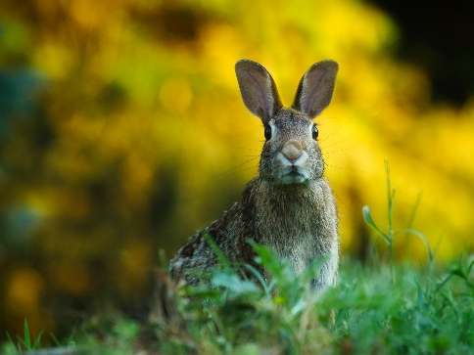
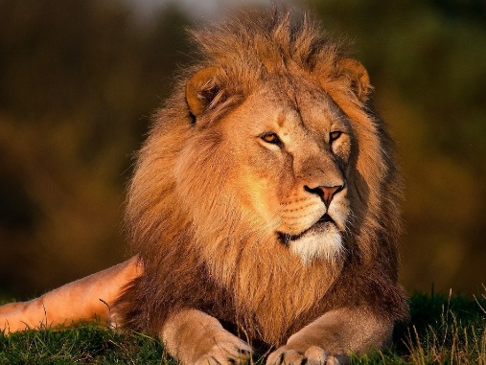
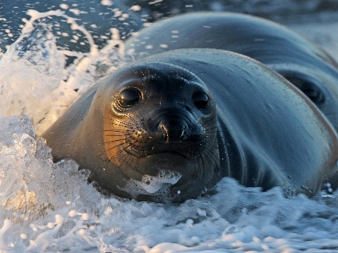
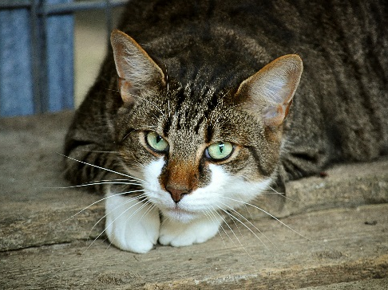
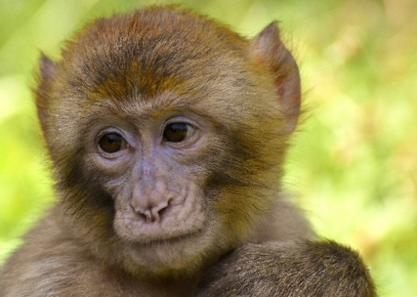
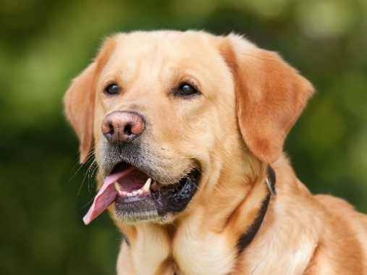
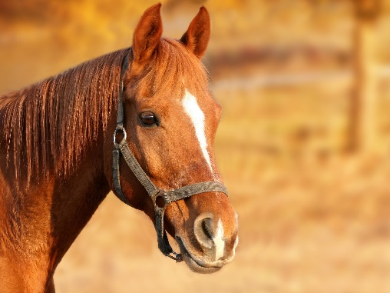
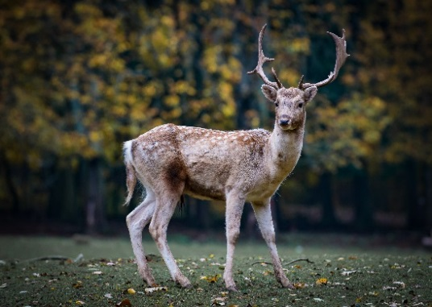
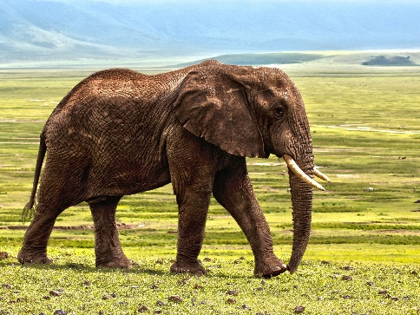
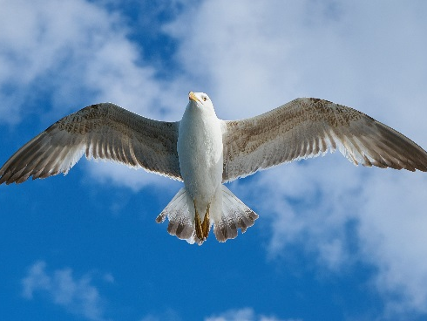
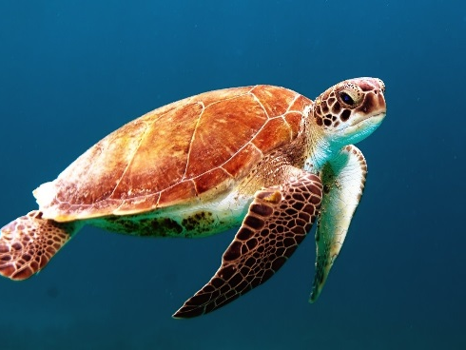
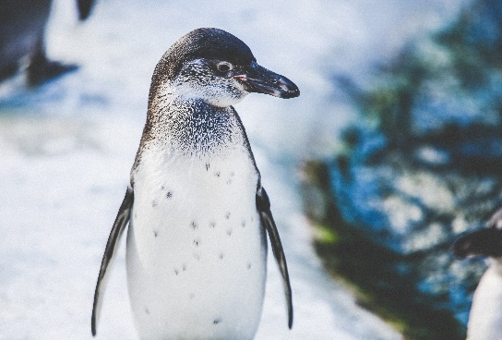
Sort these animals into groups
Notes:
Going straight into this activity will get the class thinking and talking to each other. Encourage the children to think about this for themselves: they should be able to group by basic features or what they eat. After a few minutes if they are struggling make some suggestions; where they live, what they eat, what they look like. After 5 minutes ask the group to stop and see if any children would like to tell the class which groups they have used. Get two or three different suggestions and then show how you have sorted them (next slide).

Slide 4
Plant Eaters
Meat Eaters
Notes:
You have chosen to group animals by what they eat; meat eater and plant eaters. There’s another category that you could have used.. Some animals eat plastic.

Slide 5
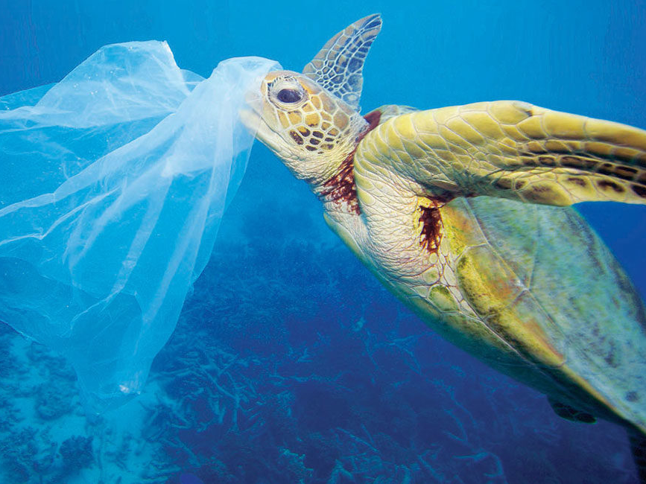
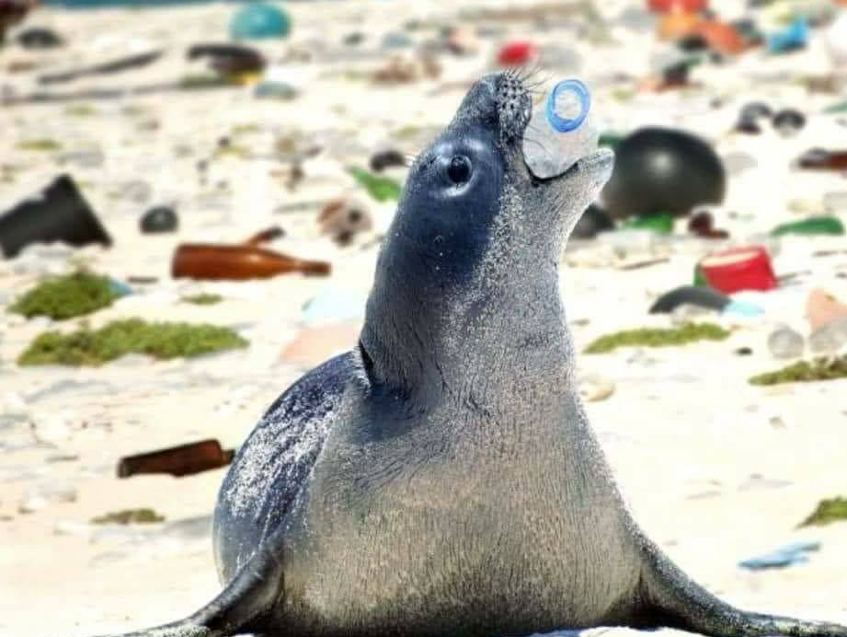
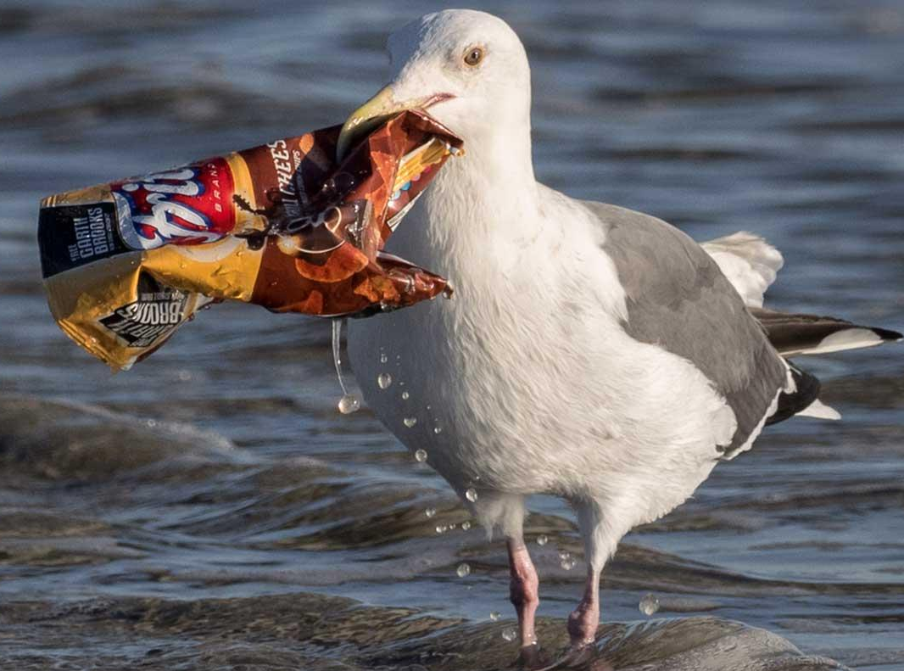
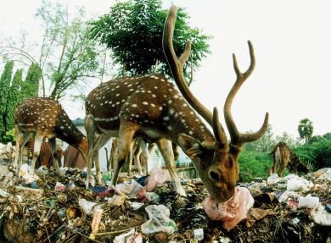
©Troy Mayne/WWF
©auxx.me
©Ingrid Taylar
©C.S. Kotteswaran
Notes:
Ask the class what is happening in these pictures?
Follow up question, Why might these animals eat plastic? Explain that animals might get confused, plastic can look like food to animals. Eating plastic is bad for animals and can make them very ill.
Make it personal (kindly!) to draw a connection with the issue

Slide 6
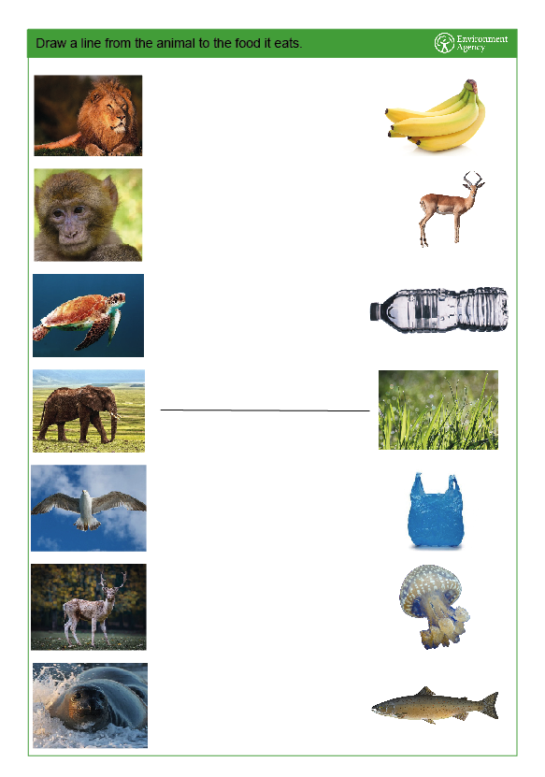
Notes:
Activity sheet, draw a line from the animal to it’s correct food.
Explain clearly what needs to be done to complete the worksheet. A line needs to be drawn from the animal to the food that it should eat. Two animals might eat the same food and some of the things on there might not be eaten by any animals.
The next slides contain the answers so do not move to the next slide until all the children are finished.

Slide 7

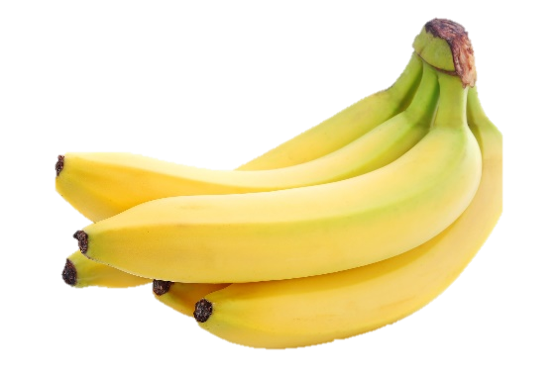
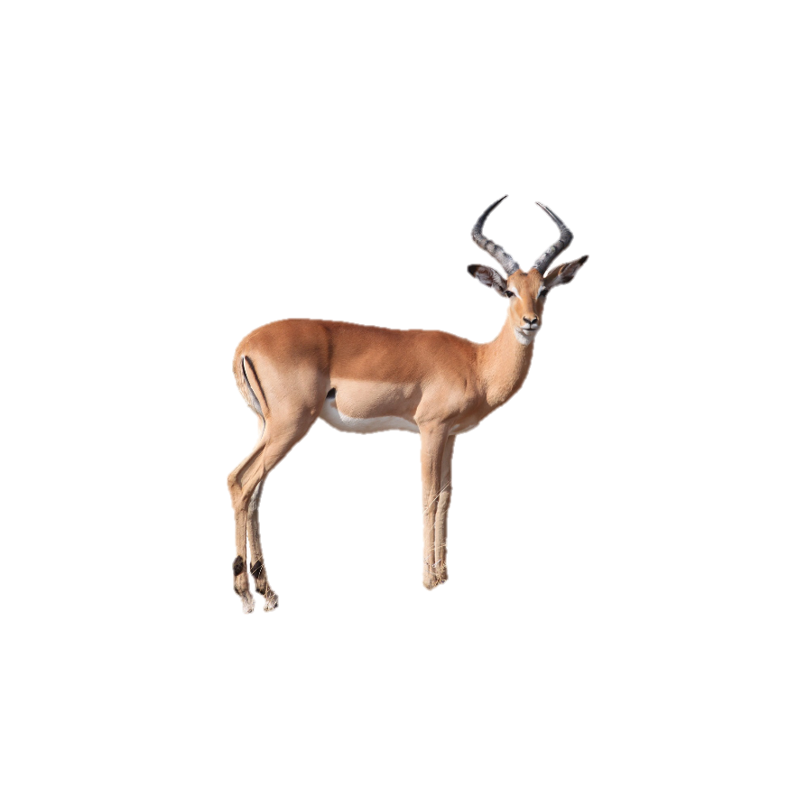
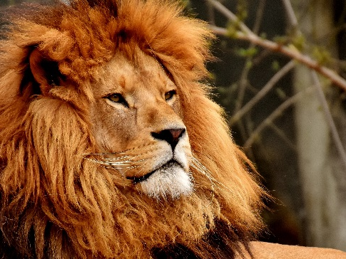
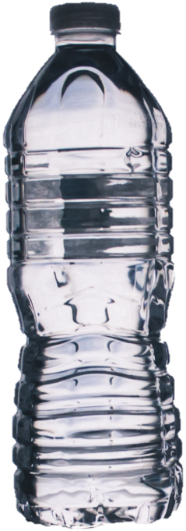
Notes:
Go through each food and ask what it is eaten by, this sets the scene for food chains next year. If needed remind them that some foods will be eaten by more than one animal and some things aren’t really food for animals. Make sure to be clear when you get to each plastic to say that some animals may eat plastic but they shouldn’t and that it’s bad for them.

Slide 8
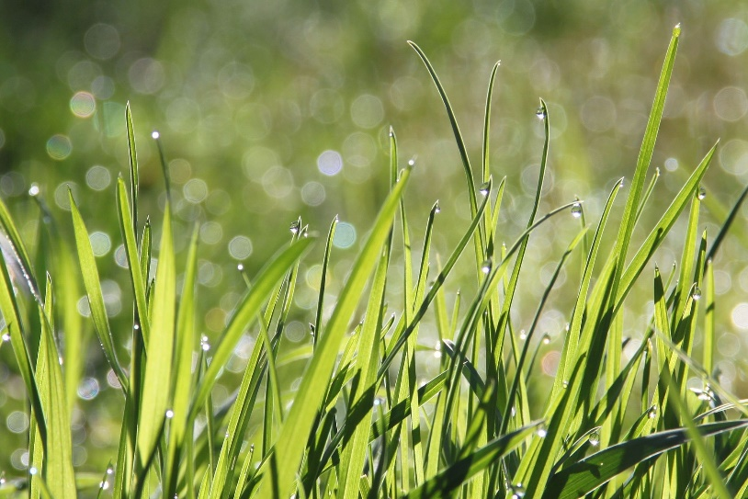

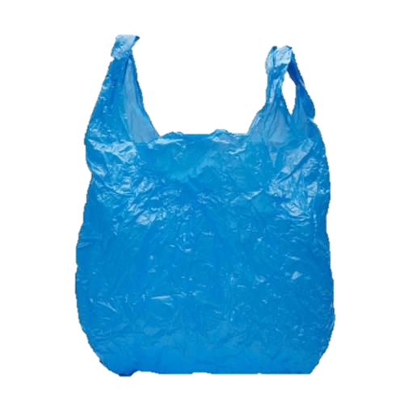

Slide 9
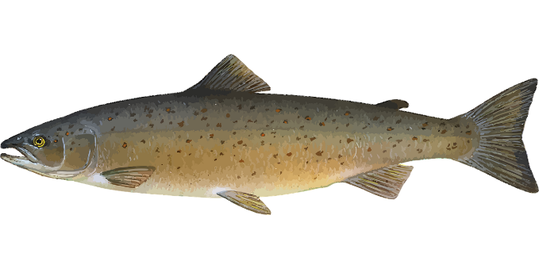
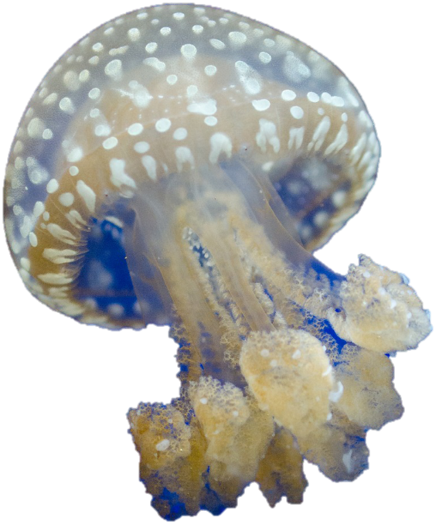

Slide 10

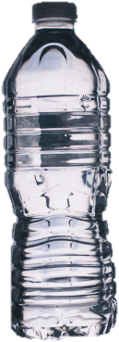



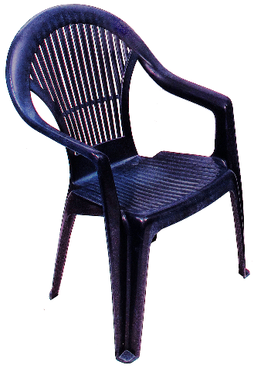
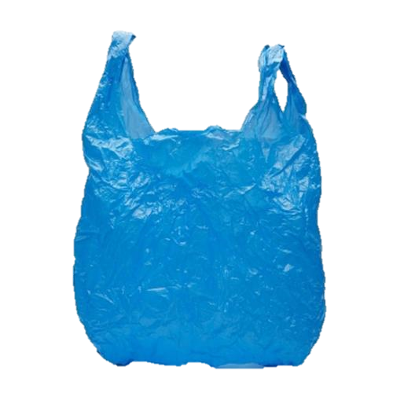
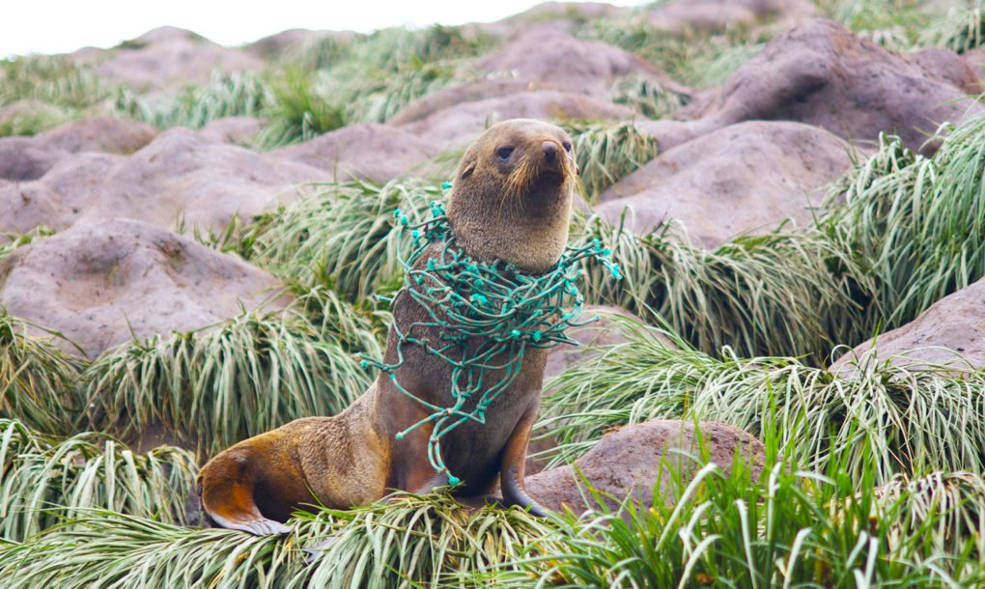
What do we already know about plastic?
Animals can eat plastic
©Troy Mayne/WWF
Lots of things are made from plastic
©inhabitat.com
Animals can get tangled in plastic
Notes:
They already know that animals can eat plastic- this can make animals ill
Some things that you know about plastic: They can get tangled in it, It can be used to make lots of useful things. We don’t want to demonise plastic. Explain that some items we only use once, that’s not a good use of plastic (bag, straw, bottle). But for other things that we use for a really long time can be a good use of plastic (chair, phone laptop).

Slide 11
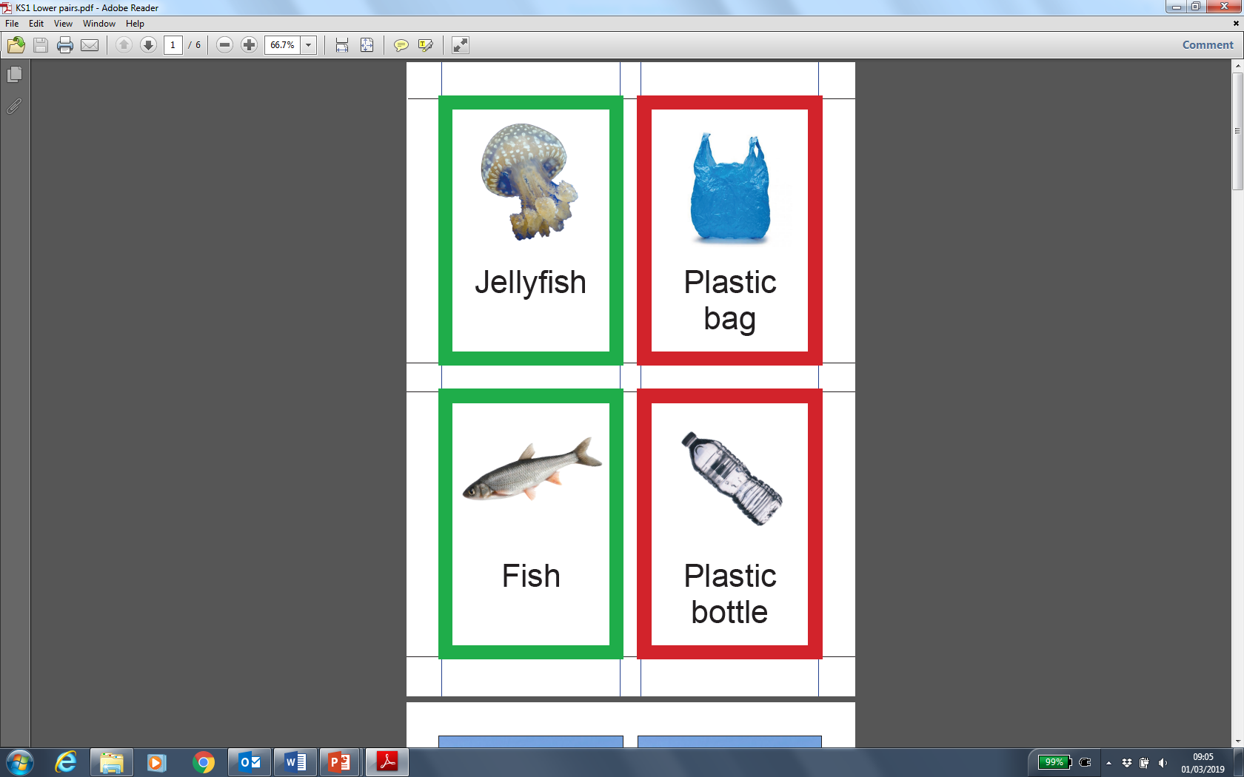
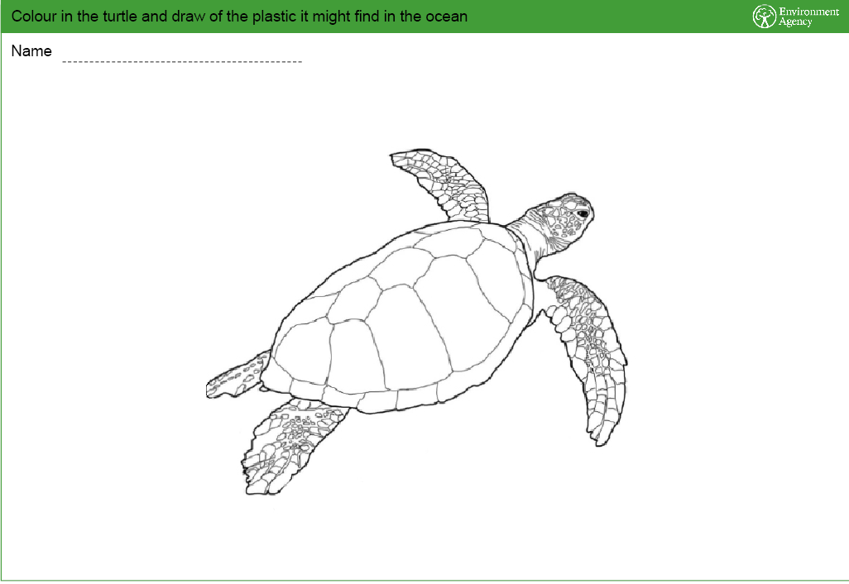
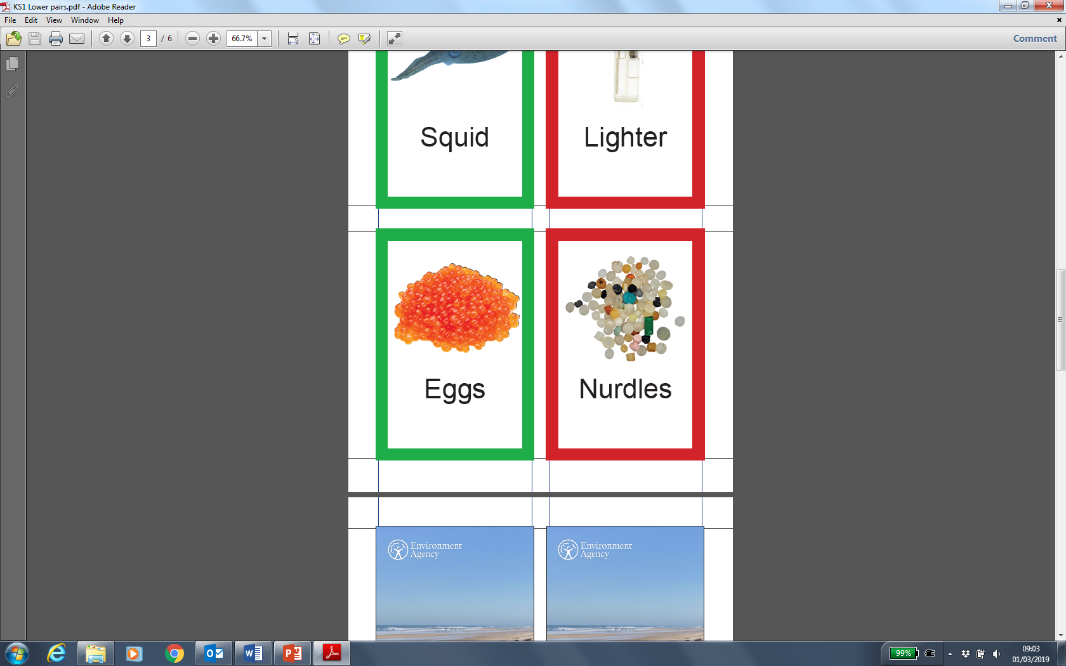
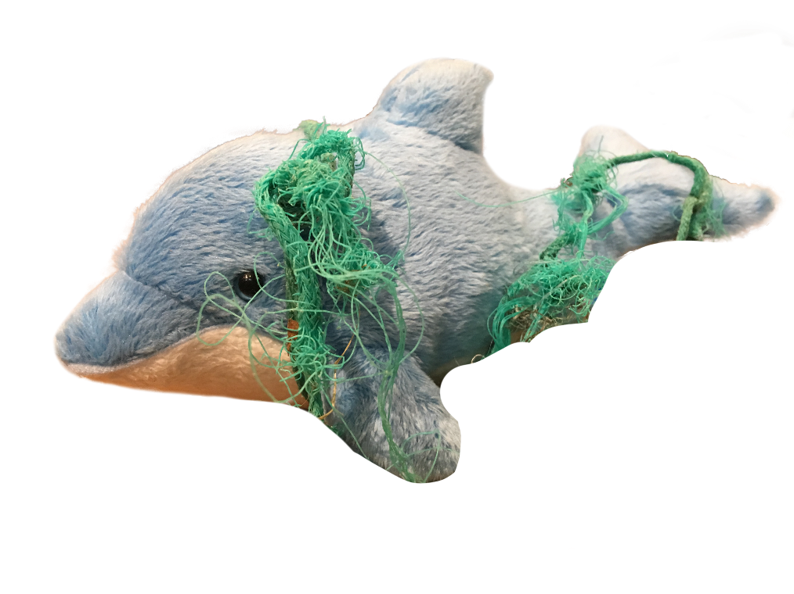
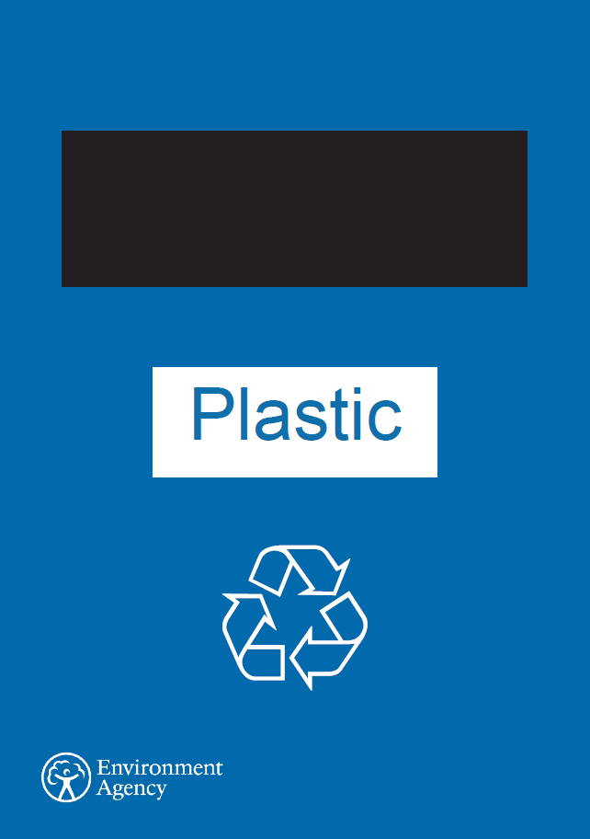
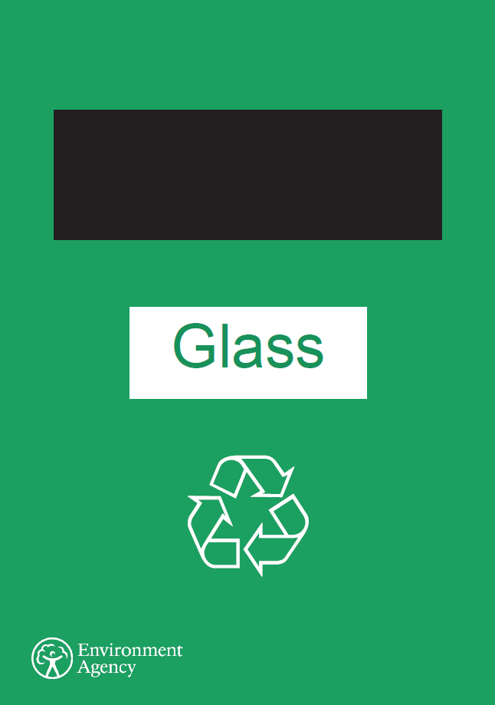
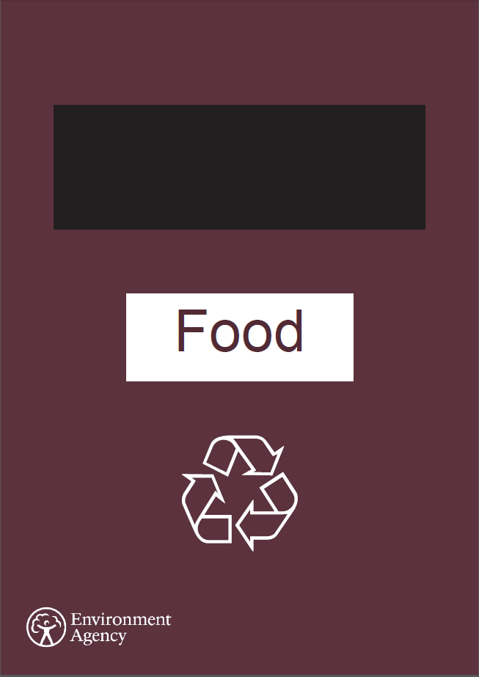
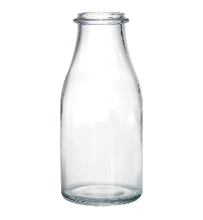
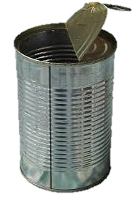
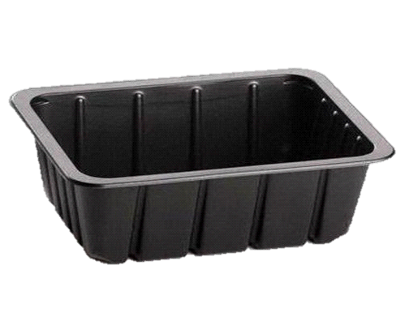
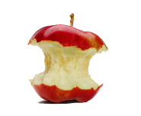
Activities
Notes:
Clearly outline what the activities are and what will be expected of them for each activity. Full descriptions of each activity are in the resource pack.
Ask questions or ask a pupil to tell the rest of the class what to do to ensure understanding of what to do.
After you have explained split the children into 4 groups. They will spend approximately 5 minutes on each activity. Once they have been split into groups and moved to tables make sure there are no more questions.
Most children will probably not have time to finish their colouring and drawing in 5 minutes, you can give the whole class a bit more time to do this at the end.

Slide 12
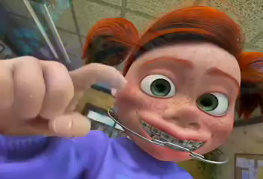
How does all this plastic get into the ocean?
Notes:
Finding Nemo clip: all drains lead to the ocean
Explain that litter that gets dropped on the street or blows out of a bin can then get washed into drains, these lead into rivers and into the oceans where animals can get tangled in it and mistake it for food.
Question: Do they ever drop litter or see people dropping it? Could they do something differently?

Slide 13
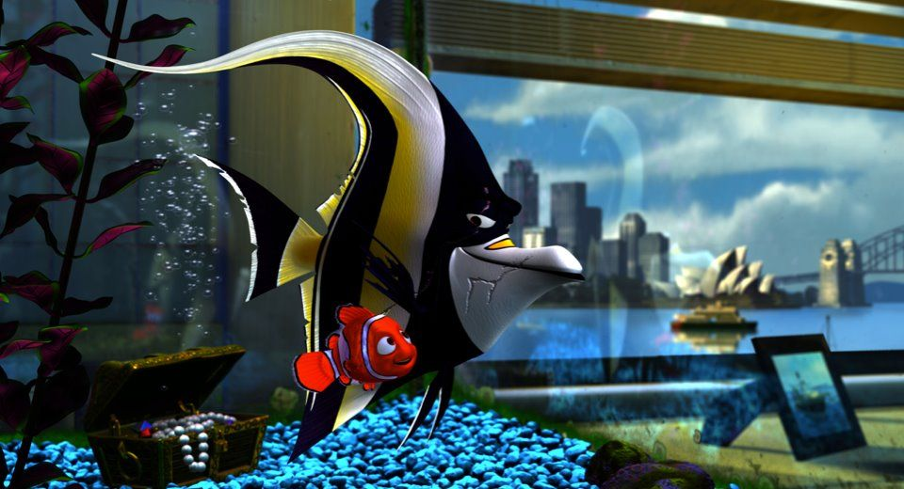
What have you learnt?
©Troy Mayne/WWF
©inhabitat.com
Notes:
Ask them what they have learnt today, the pictures can provide some prompts.

Slide 14
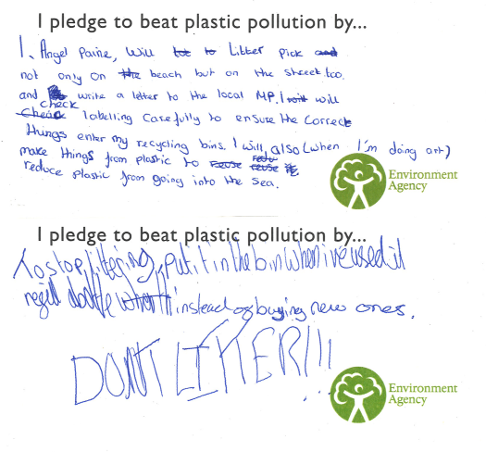
What can you do?
Notes:
Ask all the children to think of something that they could do at home, school or in a club. Here are some examples of pledges we have received (you can change these for some of your own) read these out to the class to give them ideas. They can then write this on a pledge card, tell them to keep hold of it as they will need it in a minute.

Slide 15
What can you do?
I will stop using
I will tell about what I have learnt today
Notes:
These are some prompts to help the class with their writing. This is also on the back of the Word Bank handout which the children will already have on the table. Read out the prompts and make some suggestions for what they could write in the blanks.

Slide 16
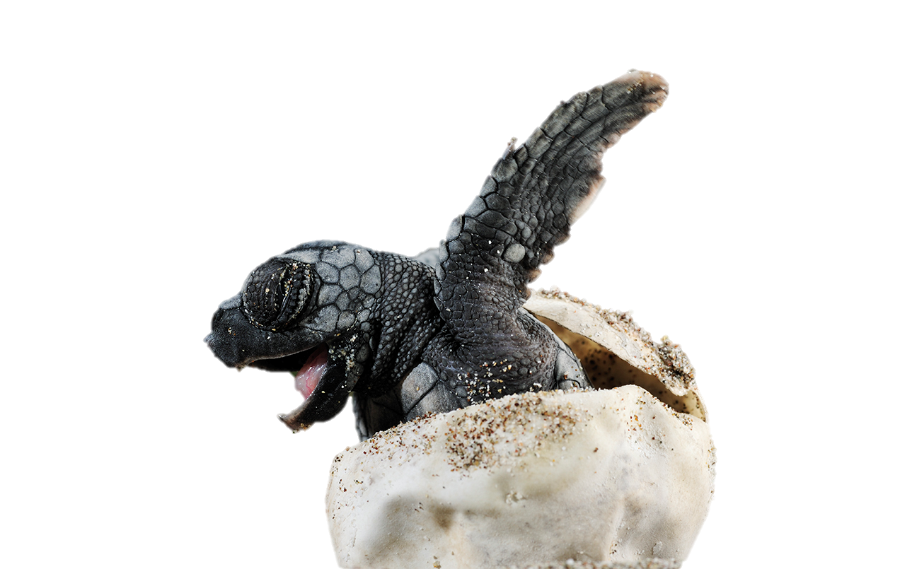
Thank you for helping to make plastic pollution a thing of the past!
Notes:
Thank all the children for listening and doing so well. Announce the fasted team for untangling the sea creature. Ask if there are any more questions.

