Slide 1
WEEE What do you need to know?

Slide 2
What is WEEE?
WEEE stands for Waste Electrical and Electronic Equipment.
An item is classed as being WEEE if it needs electricity to do what it intended to do. N.B. The electricity can come from a battery source.
You can get several types of domestic and commercial WEEE, including large WEEE and small WEEE.
The WEEE Directive was introduced in 2006 to make manufacturers and retailers responsible for collecting and recycling WEEE.

Slide 3
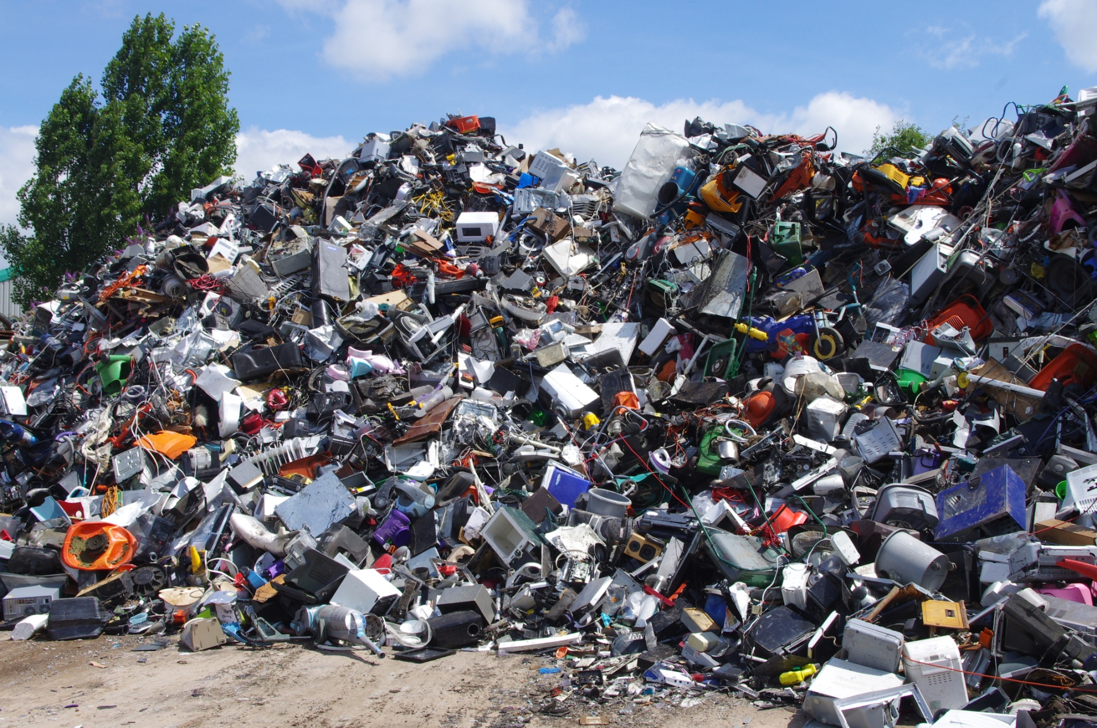
WEEE collection

Slide 4
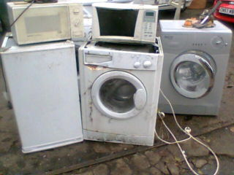
What is Large WEEE?
Large WEEE is large domestic (household) appliances such as ovens and washing machines

Slide 5
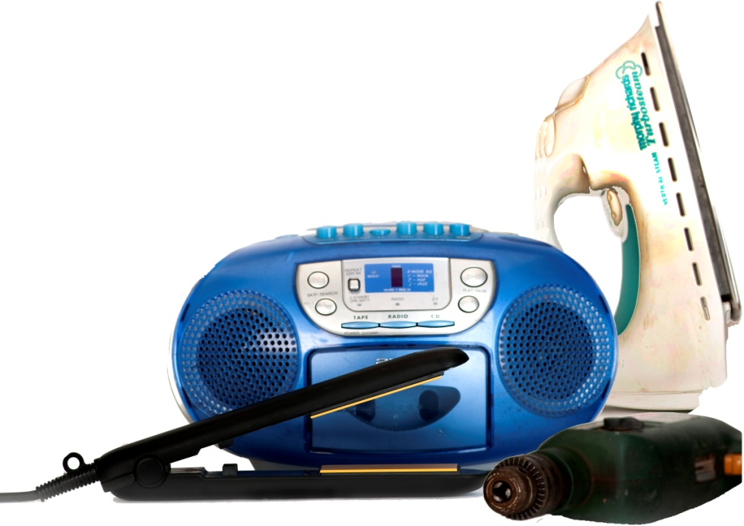
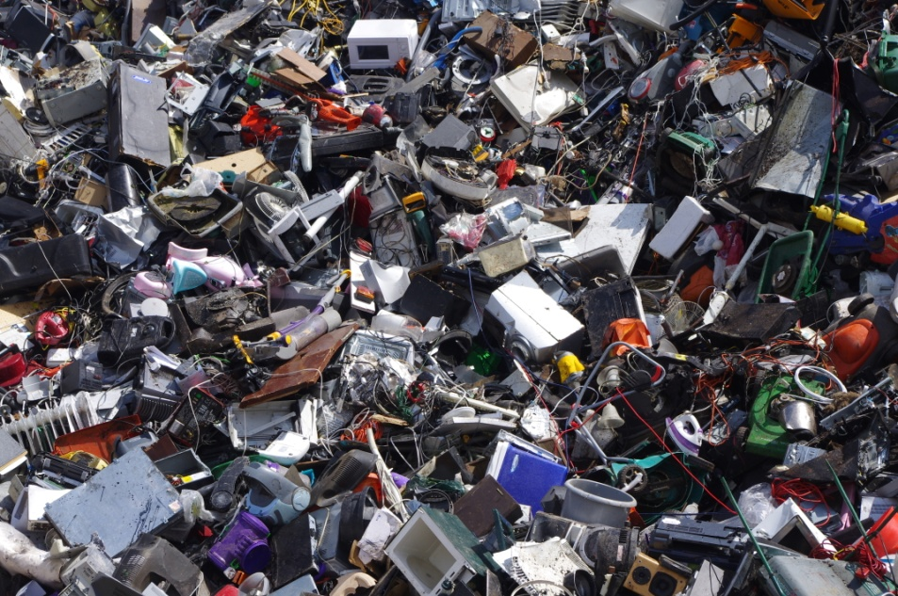
What is Small WEEE?
Small WEEE is small domestic (household) electronic equipment, such as toasters, clocks, irons and battery operated children's toys.

Slide 6
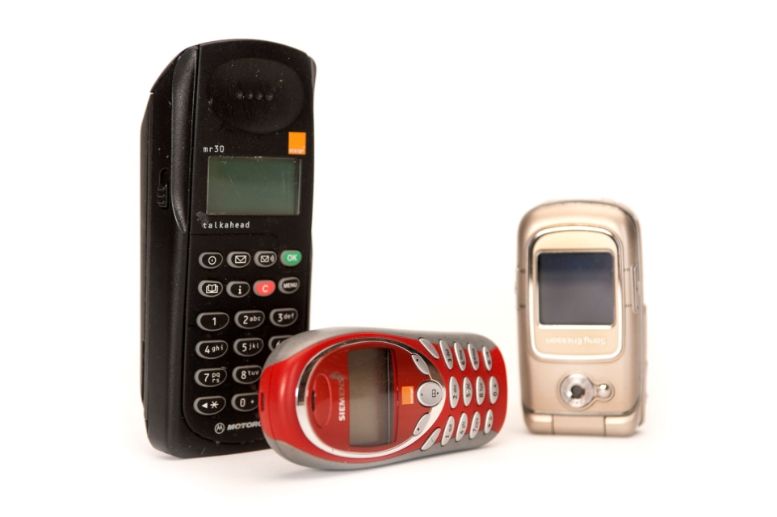
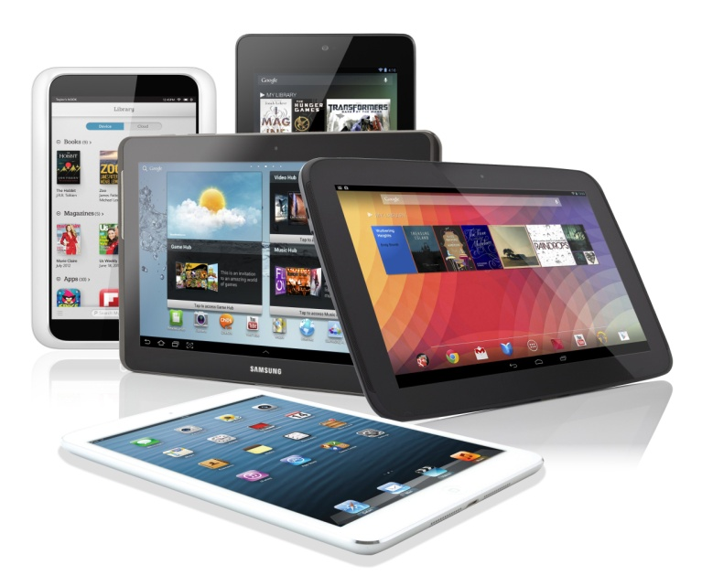
What about mobile phones and I.T. equipment?
IT and telecommunications make up a significant amount of the small WEEE category.
This includes mobile phones, laptops, tablets and gaming devices.

Slide 7
What is WEEE made from?
All WEEE goods contain valuable resources, including metals, precious metals, plastic (made from oil) and glass. All of these resources have come from our planet.

Slide 8
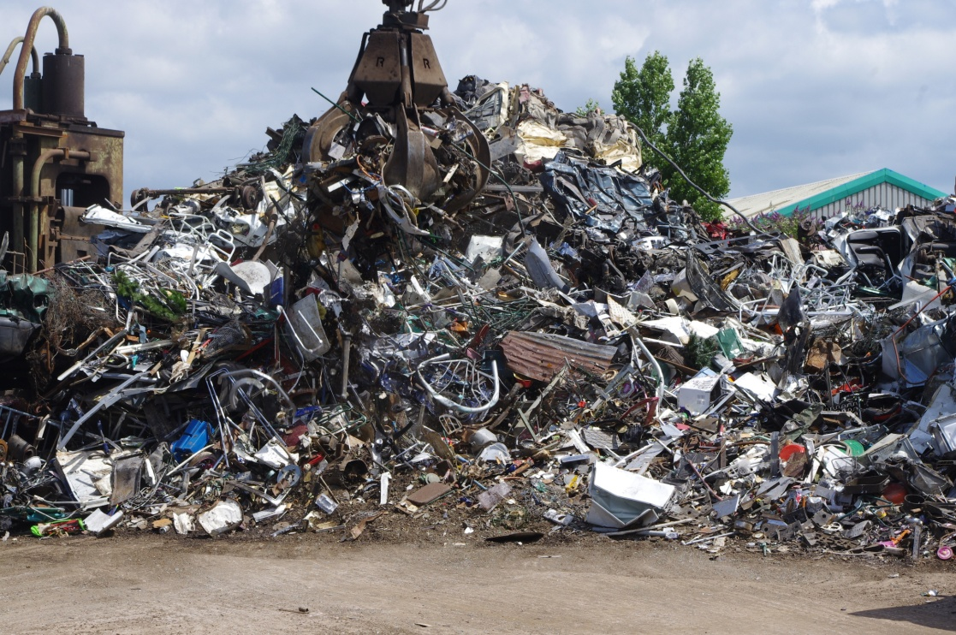
Why should we recycle WEEE?
These items should be recycled so we don’t need to use as many raw resources or energy to create more materials.

Slide 9
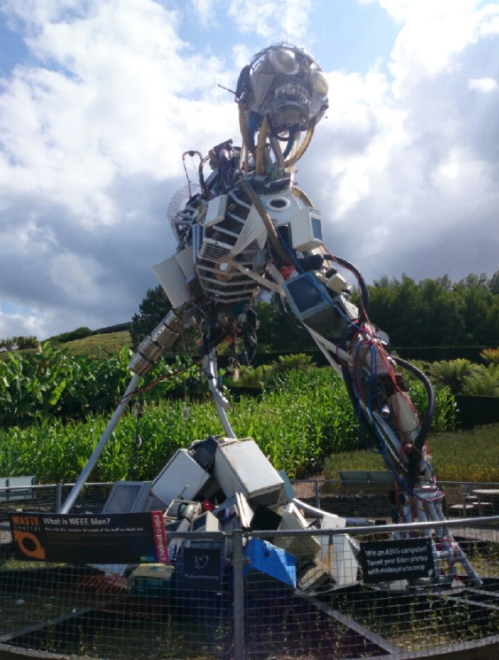
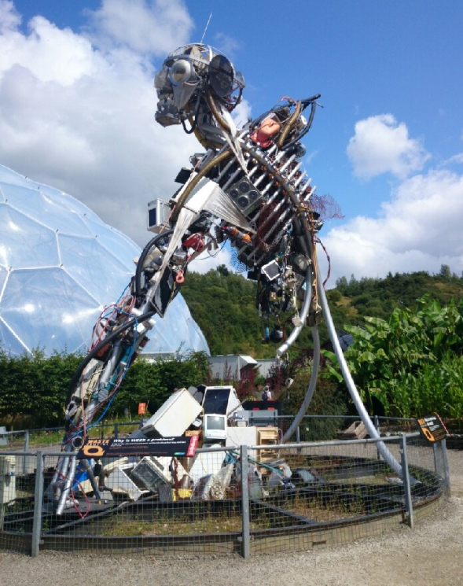
What is our impact?
On average, each person will dispose of 3.3 tonnes of WEEE waste in their lifetime.
The WEEE Man was created to demonstrate what this amount of waste could look like.
www.weeeman.org

