Slide 1
Material World
Textiles PowerPoint for lessons 1 and 2

Slide 2
Acrylic
Cotton
Nylon
Polyester
Silk
Viscose
Leather
Rayon
Spandex
Linen
Wool
Natural fibres
Synthetic fibres
Natural or Synthetic Challenge

Slide 3
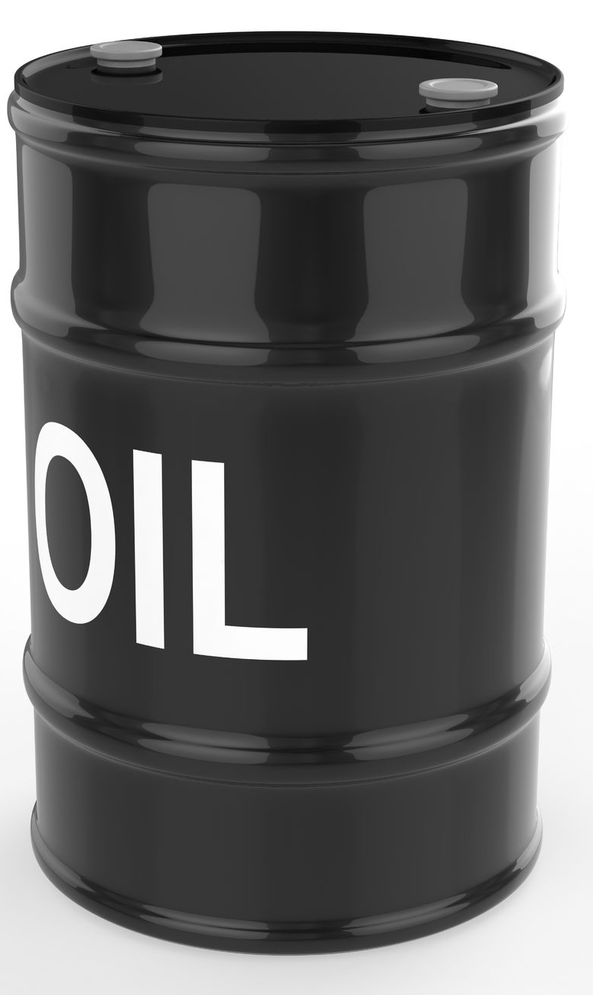
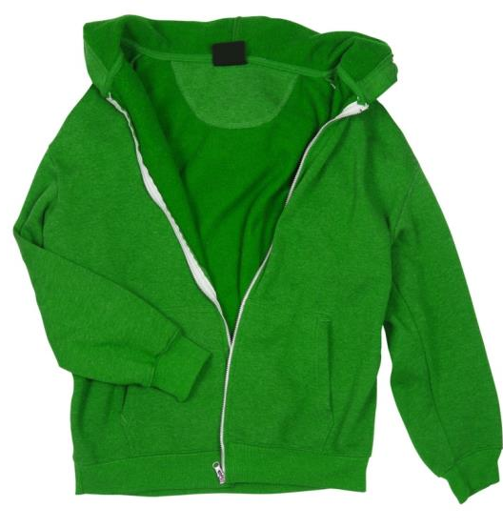
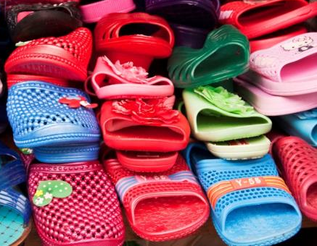
Synthetic fibres - 40% of our clothes contain oil

Slide 4
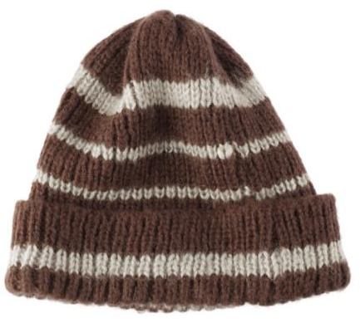
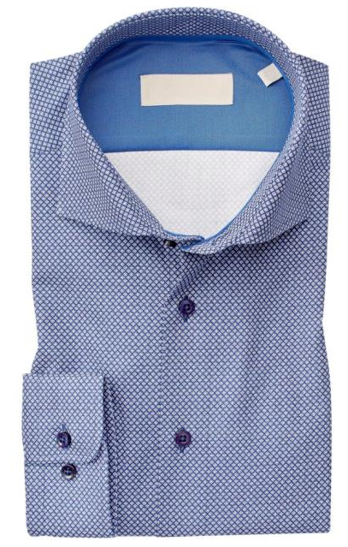
Natural fibres - made from plants and animals

Slide 5
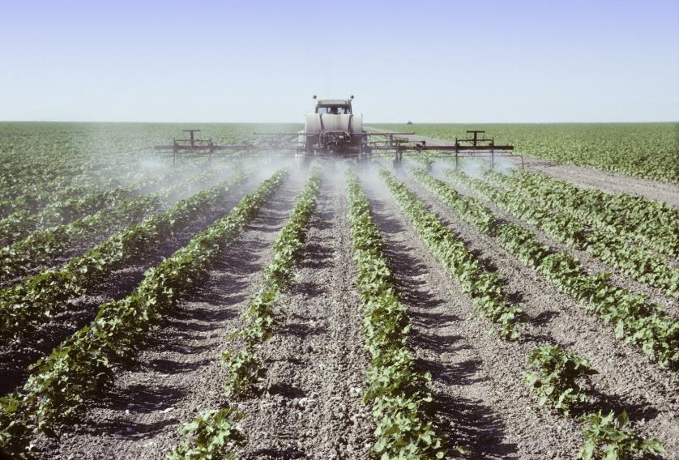
Making 1kg of cotton fabric uses:
8 litres of oil
300g of chemicals e.g. pesticides
20,000 litres of water
150g of dyes
Notes:
1kg of cotton uses 20,000 litres of water & 300g chemicals/pesticides, 150g dyes, 8 litres of oil
Ref: http://wwf.panda.org/about_our_earth/about_freshwater/freshwater_problems/thirsty_crops/cotton/

Slide 6
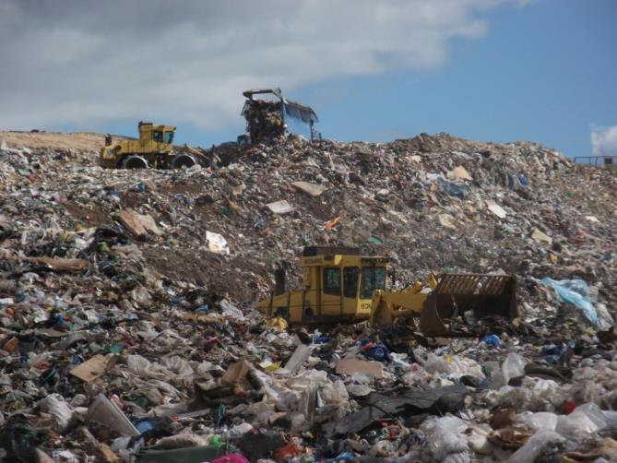
Where does our waste go?
Energy from Waste plant
Landfill site
Notes:
Most rubbish in Devon (31%) goes to an Energy from Waste (EfW) plant where it is incinerated (burnt) at high temperatures to generate electricity. Some rubbish in Devon (14%) is buried in landfill sites. Whichever method of disposal is used, when we burn or bury rubbish we lose valuable resources which could have been preserved and used again.

