Slide 1
Digital Media literacy
Pshe/english

Slide 2
Our beautiful county: devon in Autumn
How would you describe it to someone who’d never been here? Think about the colours.

Slide 3
dartmoor
How would you describe it to someone who’d never been here? Think about the shapes of the stones, the sights and sounds of the moorland.

Slide 4
What about these places?
What does this make you think? Are they beautiful?

Slide 5
Watch the Bbc bitesize video
https://www.bbc.co.uk/bitesize/clips/zw8mtfr

Slide 6
Evaluating digital content
Who wrote the content? Was it a company? Government? Individual?
Why was it written? Do you trust the author?
Is the information out of date?
What does the design of the website tell you?
What might the ranking of the website in the search engine tell you? (Look for promotion of sponsored material or popular sites)

Slide 7
4 principles of digital literacy
When looking at items online you must consider these things:
Comprehension – can you understand what the writer is trying to say? What is the article about? What is the purpose of the article/video/picture/video/meme?
Interdependence – what is the source of the article/video/picture/video/meme? Who made it? Where is the information contained in it from? Is it a reputable and verifiable source?
Social Factors – who shared this with you? Was this suggested to you because of something else you clicked on? Who will you share it with? (THINK BEFORE YOU CLICK!)
Curation – how is this stored and collected? Think about Pinterest boards.

Slide 8
Snowdonia national park
This is the lake above Snowdon.

Slide 9
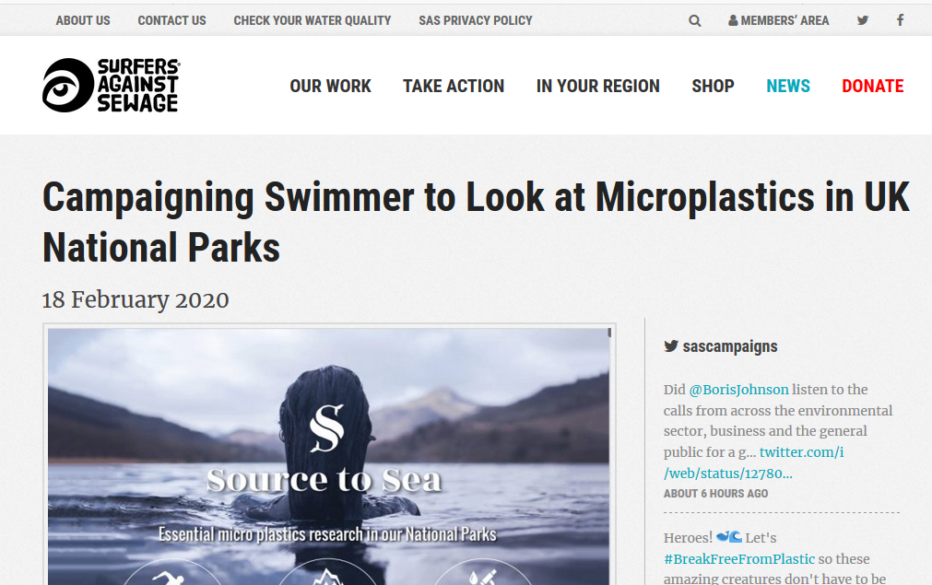
Compare these articles:
https://www.sas.org.uk/news/campaigns/campaigning-swimmer-to-look-at-microplastics-in-uk-national-parks/
https://www.bbc.co.uk/news/uk-wales-51546978
https://www.jlimnol.it/index.php/jlimnol/article/view/jlimnol.2019.1943

Slide 10
microplastics
What are they?
Where do they come from?
How do they end up on Snowdon?
Tiny pieces of plastic
5mm long
Fleeces
Face creams, toothpaste and moisturisers
Bigger pieces of plastic breaking down in the environment
Brought in rain
Washed off people’s clothes
Litter breaking down

Slide 11
Now write your own article:
Write in paragraphs
Title
Remember to consider the audience – who are you writing for?
Remember to use the features of a non-chronological report:
Write in formal and factual language
Picture
Include your source
Write in third person
Introduction

Slide 12
Use the 4 Principles of Digital Literacy to think about the article:
Is it understandable? Does it make sense? Comprehension
Is it clear where the information has come from (your source) Interdependence
Does it give a reason for people to share it ? Social Factors
Where will it be held ? Curation

Slide 13
Extension work
Think up a meme or short video to accompany your article
Where could you share it to have the most impact?

Slide 14
Plenary: Actions against plastic
What do you think we can do to help the plastic pollution problem? Think about where plastic comes from when it ends up in the environment?
Could you start a campaign at school/home?
Look at Plastic Free Schools
Is this different for microplastics? Think about fleeces, washing machines, plastic in cosmetics.

