Slide 1
Welcome to the
Exeter EfW
Quiz
KS2 v1

Slide 2
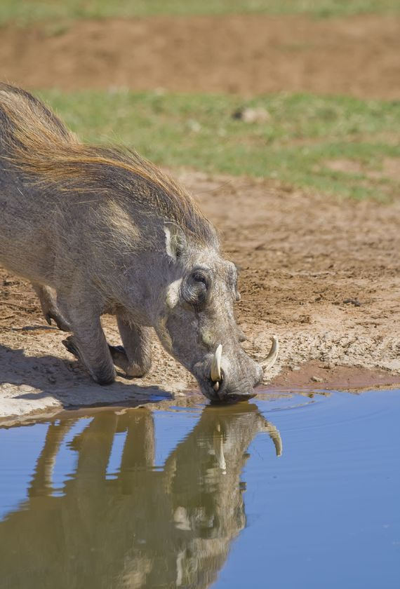
What does EfW stand for?
a) Electricity from Water
b) Energy from Waste
c) Environment for Warthogs
d) Energy free World

Slide 3
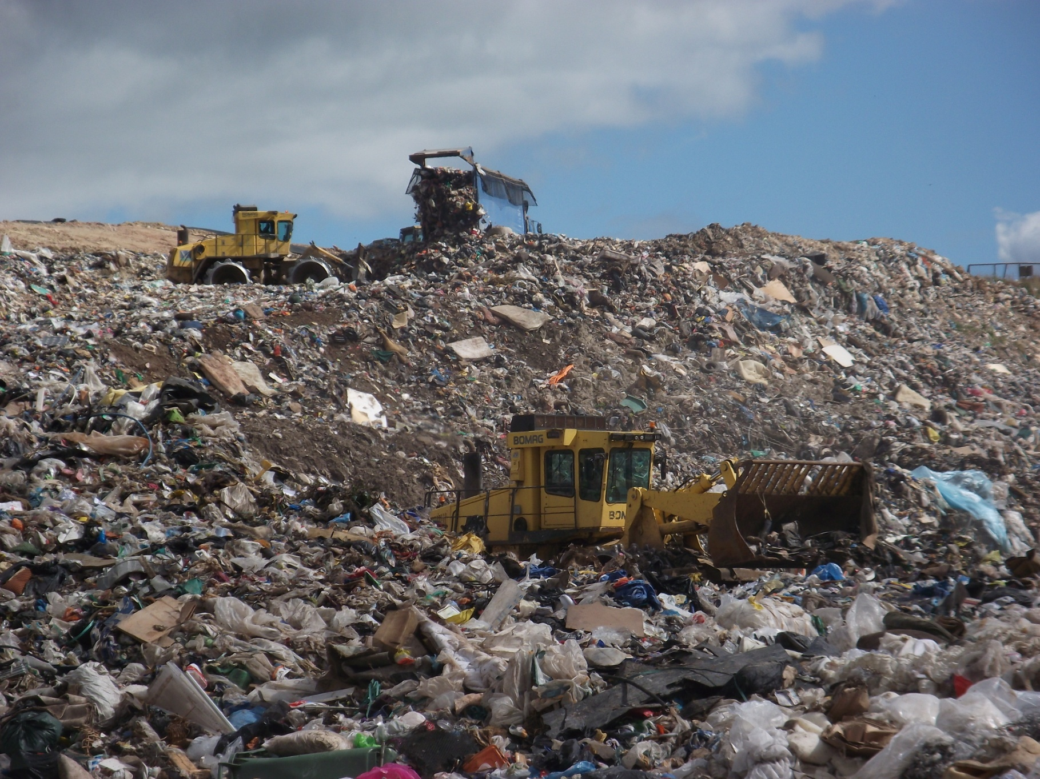
What is the technical name for the big hole where our rubbish used to be buried?
a) rubbish dump
b) landfill site
c) junk yard
d) the tip
Notes:
2015: North Devon, Torridge and Mid Devon are still sending their residual to landfill until another option is found.

Slide 4
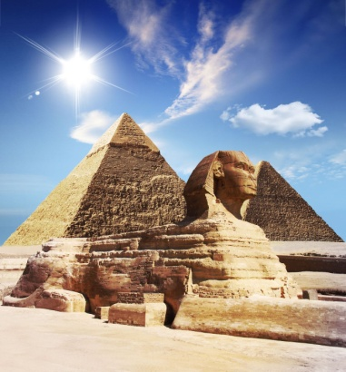
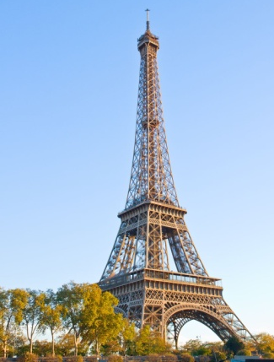
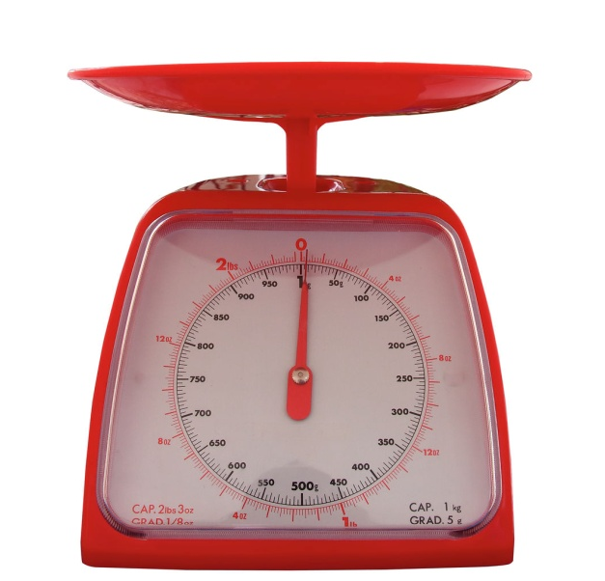
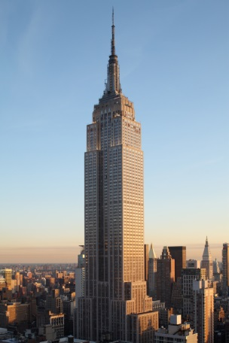
How much rubbish and recycling did people in Devon throw away in 2018-19?
This is the same weight as...
a) the Great Pyramid of Giza
b) the Eiffel Tower
c) the Empire State Building
a) 350 grams
b) 3,500 kilograms
c) 350,000 tonnes
Notes:
Empire State Building – 365,000T - 381m high – limestone, granite, 10million bricks, alu and steel
Pyramid of Giza – 5,900,000T - 139m high - oldest of the Severn wonders of the world, constructed 2560BC
Eiffel Tower – 7,300T - 301m high – metal girder structure

Slide 5
120,000 tonnes of Devon’s waste is sent to the EfW process each year. This is the same weight as how many blue whales?
c) 63
a) 632
b) 6320
Notes:
The blue whale is the heaviest animal ever to have lived; an adult weighs 190 tonnes.

Slide 6
Each lorry dumps about 6½ tonnes of waste. That’s the same weight as...
a) a meerkat
b) a blue whale
c) a guinea pig
d) an African elephant

Slide 7
The grabber usually lifts 1 tonne of waste. That’s the weight of...
a) a scooter
b) a motorbike
c) an aeroplane
d) a car

Slide 8
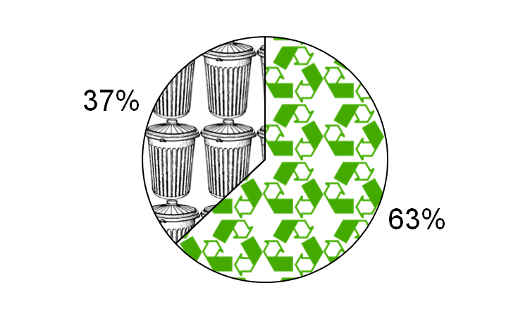
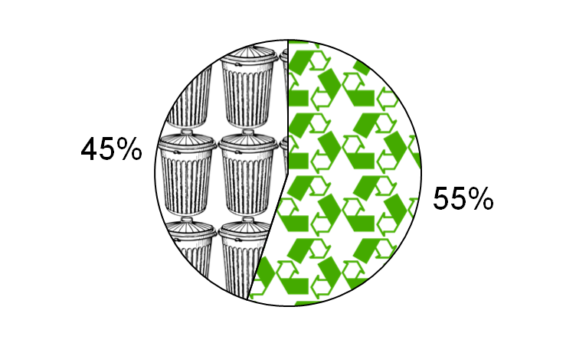
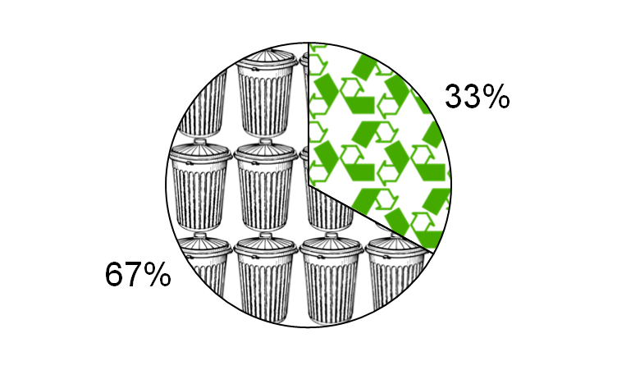
Which pie chart shows how much of Devon’s waste is currently recycled?
A
B
C
Notes:
A is Austria’s recycling rate, the best in Europe. (If they can do it in Austria, we can do it in Devon!)
C is Devon’s recycling / composting rate from 2004/5 (Haven’t we done well to improve in the last 10 years?)

Slide 9
How many lorry loads of waste are delivered here each week?
a) 7
b) 22
c) 45
That’s over 8,000 lorries each year!
d) 154
Notes:
On average (July 2014 – Jan 2015) 22 lorries unload their waste here each day (approx. 16 household, 3 trade and 3 recycling centres)* this includes a few tipping at the weekend, making 154 lorries unloading each week. Each lorry tips an average of 6.7T. (154 lorries x 52weeks = 8,008 lorries per year x 6.7T = 53,654T tipped per year
Video clip of lorry arriving tipping to be inserted.

Slide 10
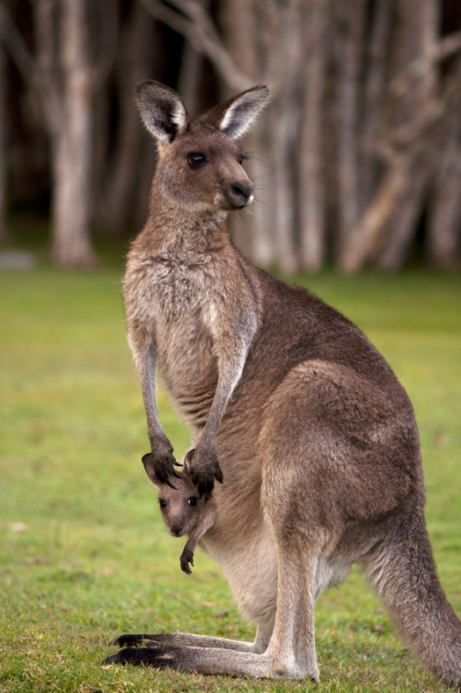
The waste is picked up using a grabber and dropped into a...
a) runner
b) hopper
c) skipper
d) jumper
Notes:
Video footage here of waste going into hopper.

Slide 11
The kiln oscillates which means it...
a) Makes a loud rattling sound
b) Gets hotter and colder
c) Bounces up and down
d) Rocks to and fro
Click to replay the video
Notes:
After showing answer, click to launch video of kiln oscillating. If you / the children would like to see it again, click on the black rectangle. Otherwise click anywhere else to go on to the next question.

Slide 12
Which gas is essential to burn rubbish?
a) oxygen (O₂)
b) carbon dioxide (CO₂)
c) hydrogen (H₂)
d) methane (CH₄)

Slide 13
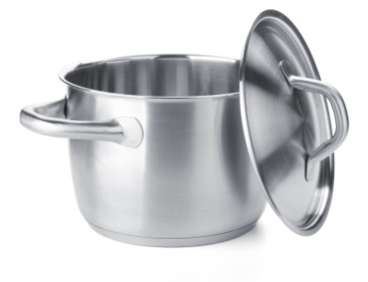
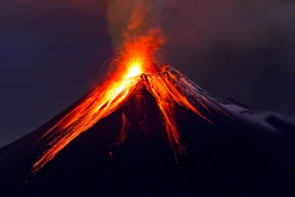
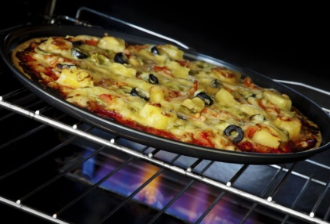
The temperature in the combustion chamber must reach what temperature?
a) 3,550°C
The melting point of diamonds
The melting point of stainless steel
The temperature of volcano lava
The temperature of an oven to cook pizza
b) 1,400°C
c) 850°C
d) 200°C

Slide 14
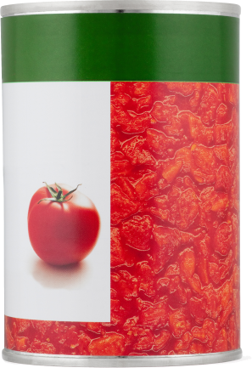
Which two materials can be removed from the ash after the rubbish has been incinerated?
What is used to remove these ferrous metals?
a) a magnet
plastic
iron
paper
food
steel
textiles
garden waste
cardboard
rubber
b) a sieve
c) warm water
d) hot air
Click the magnet to replay the video
Notes:
Use real magnet used during session to demo, so children make the link with school science lessons. Show examples of actual things that have been removed by the electromagnet.
Video will launch on a click, after the can has stuck to the magnet. To watch it again click on the lower pole of the magnet.
Possible extension question: what would be a better thing to do with your steel things like cans ie put them in your recycling container.

Slide 15
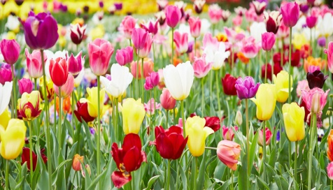
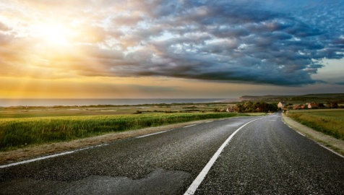
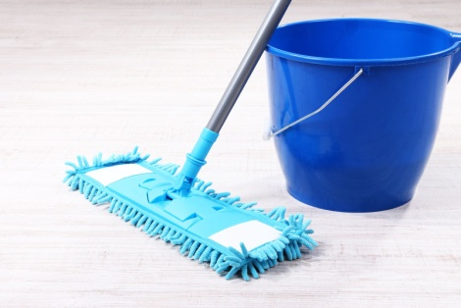
What can the bottom ash from the combustion chamber be used for?
a) fertilising flower beds
b) building roads
c) flavouring curries
d) cleaning floors

Slide 16
During the EfW process, heat is produced. How is it used?
Click to replay the video
Notes:
Open-ended discussion. (It might be useful to have a timer so you can give the group a specified period e.g., 20 seconds.)
Normal click to launch video after the discussion.
Click on the little image to replay the video if you need to – otherwise a normal click to progress to the next slide.

Slide 17
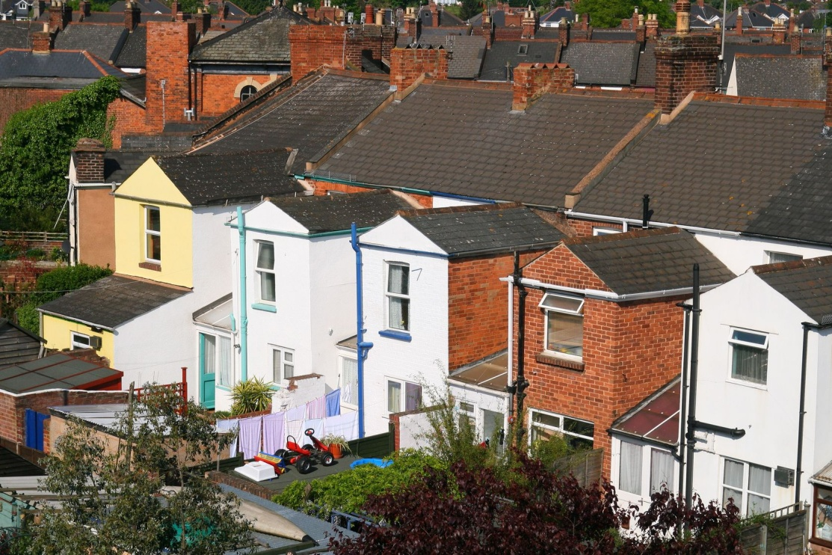
The Exeter EfW process produces enough electricity to power how many family homes each year?
a) 5
b) 500
c) 5,000
d) 5,000,000
That’s 1 in 10 homes in Exeter!

Slide 18
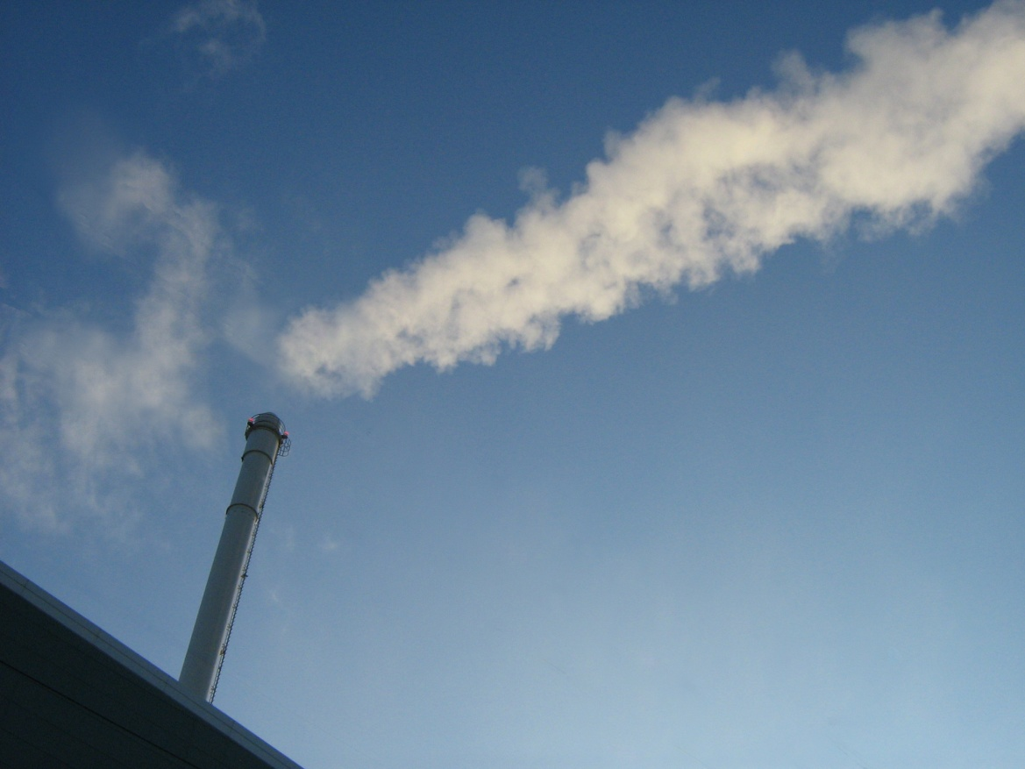
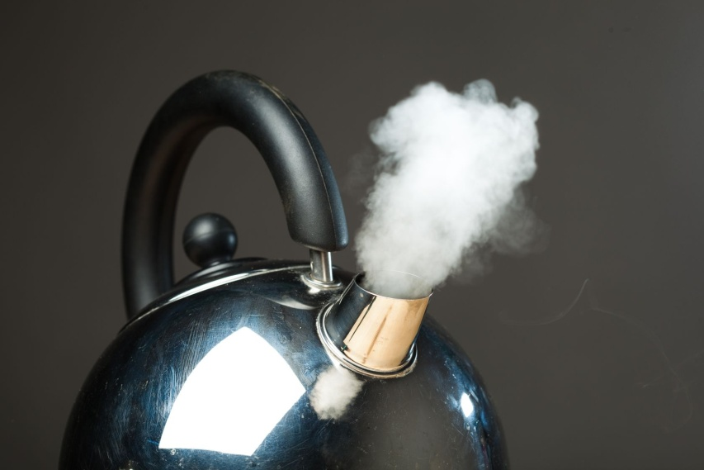
15% of the gas emitted from the plant is...
a) oxygen
b) helium
c) steam
d) soot
e) nitrogen
Notes:
The gas consists of 66% Nitrogen, 15% water, 11% oxygen and 7.35% CO2. The rest 0.65% consists of tiny, tiny amounts of other gases: Oxides of Nitrogen / Carbon Monoxide / Sulphur Dioxide / Chlorine / Ammonia / Volatile Organic Compounds / Dust
In comparison; dry air outside naturally consists of 78% nitrogen, 21% oxygen, Argon 0.9%, CO2 0.037% and tiny, tiny amounts of other gases: hydrogen, argon, neon, helium, krypton and xenon**.
Exeter EfW building is 22m in height and the stack 60m

Slide 19
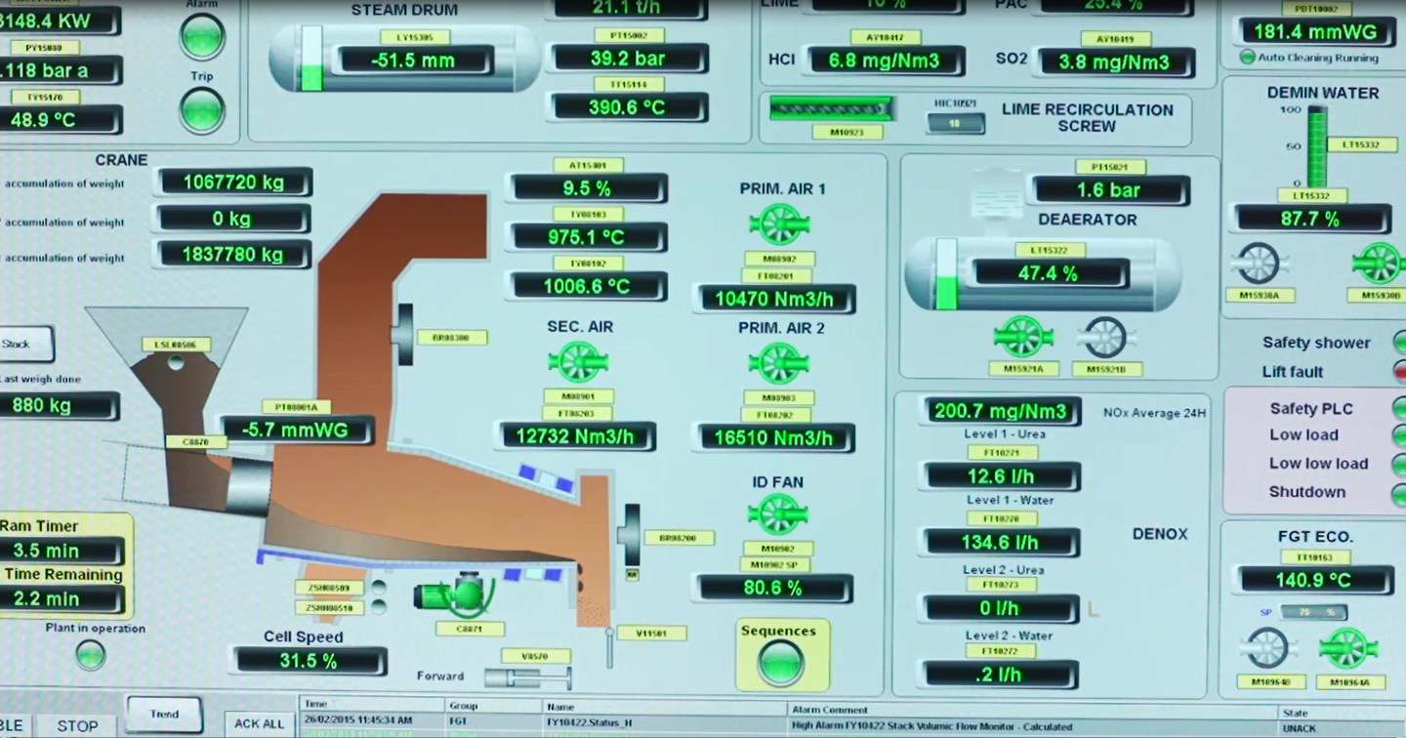
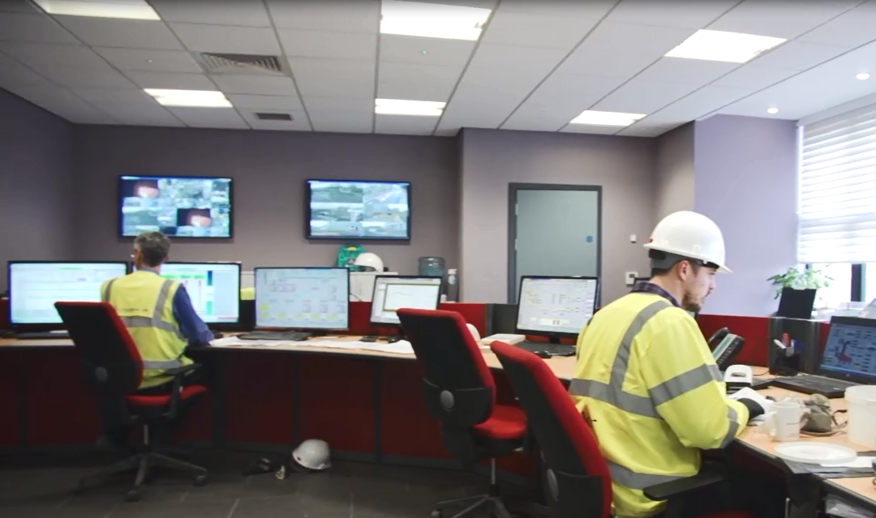
How do staff use the computers in the control room?
Notes:
Could be some amusing answers! Checking Facebook, emailing their friends, booking a holiday...

Slide 20
What are the 3Rs ?
Refrain
Reduce
Reheat
Research
Reuse
Reward
Record
Recycle
Repeat
Notes:
Others are:
Repurpose – reuse is using plastic bottle as a plastic bottle – repurpose is using it as a scoop, junk modelling etc
Reheat – using left over foods
Refuse – no thanks to plastic bags in shops
Refill – plastic drinks bottles
Repair – clothing
Revamp – furniture, old clothing

Slide 21
Can you do the 3Rs actions?
Reduce
Reuse
Recycle

