Slide 1
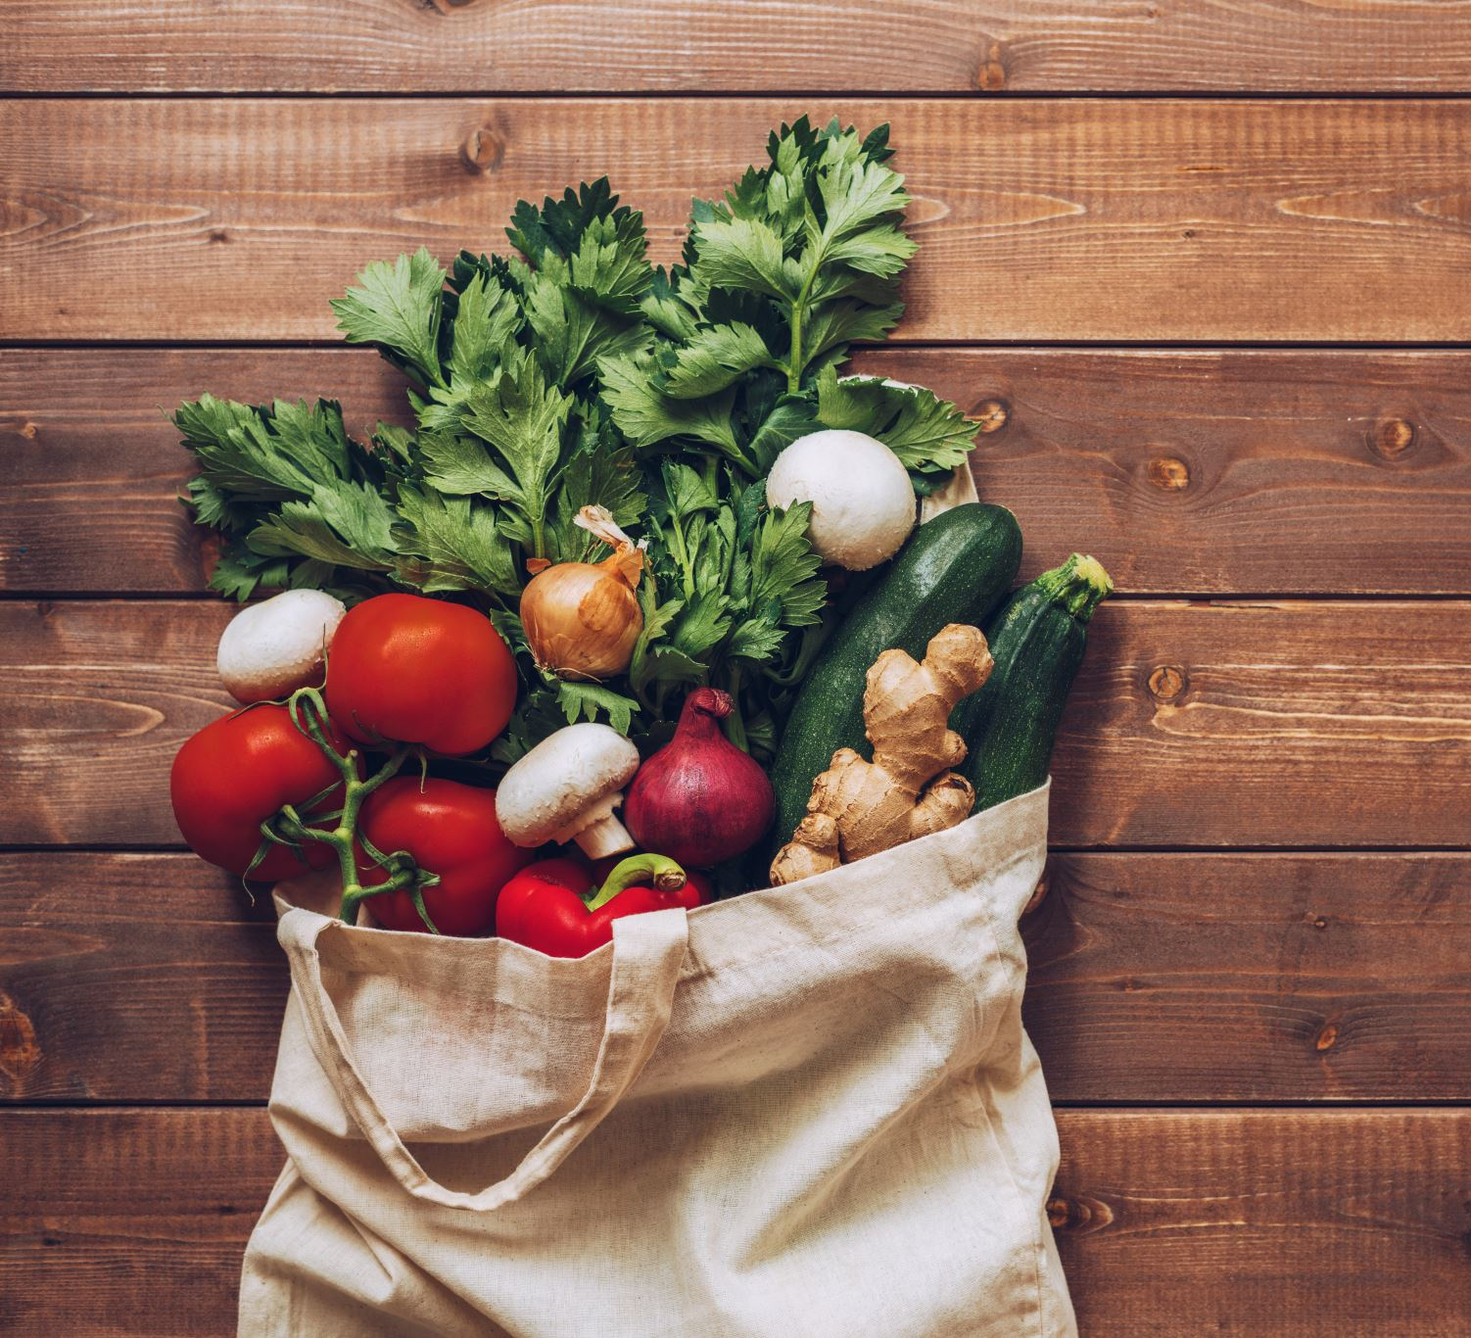
Zero Waste Lunches
Assembly ideas

Slide 2
What’s in your lunchbox?
Crisps
Fruit
Chocolate bar
Vegetable sticks
Sandwiches
Yogurt

Slide 3
If we were to look in the rubbish bin after lunch – what would we find?
Crisp packets?
Cling film?
Plastic bags?
Plastic bottles?
Juice cartons/pouches?
Wrappers?
Straws?
Paper napkins?
Food?

Slide 4
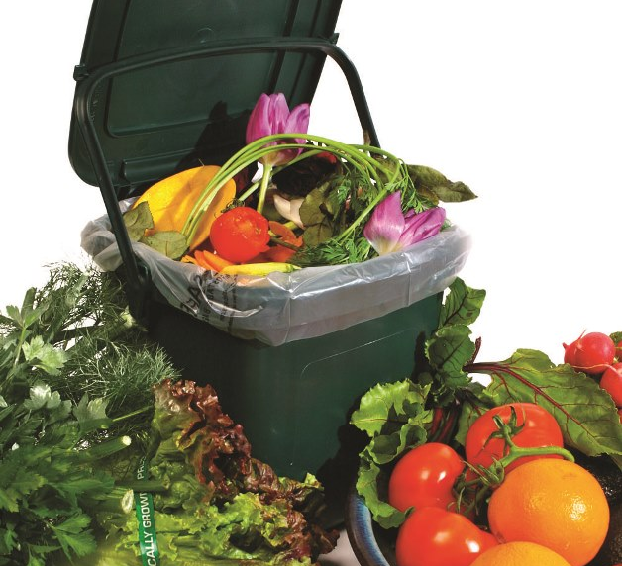
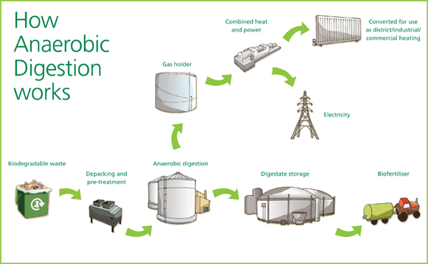
Food Waste
Goes to anaerobic digestion
Bugs generate methane
Methane burnt to power a steam turbine

Slide 5
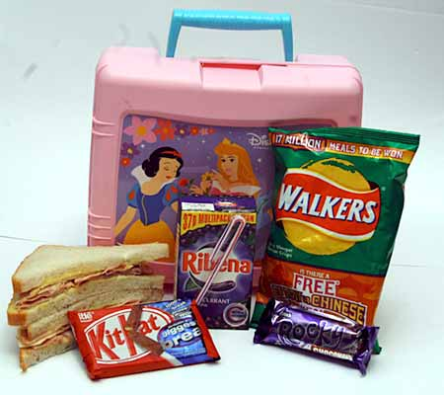
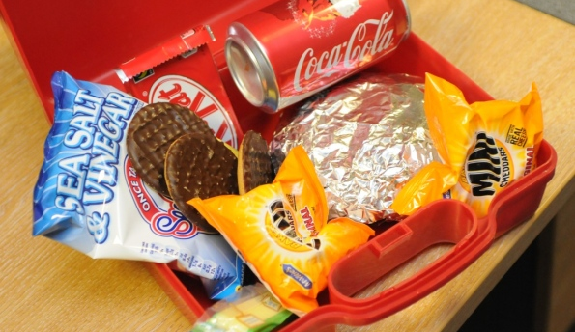
Food Packaging
Mostly made of plastic
Some, like yogurt pots, can be recycled
Processed food is not usually healthy food

Slide 6
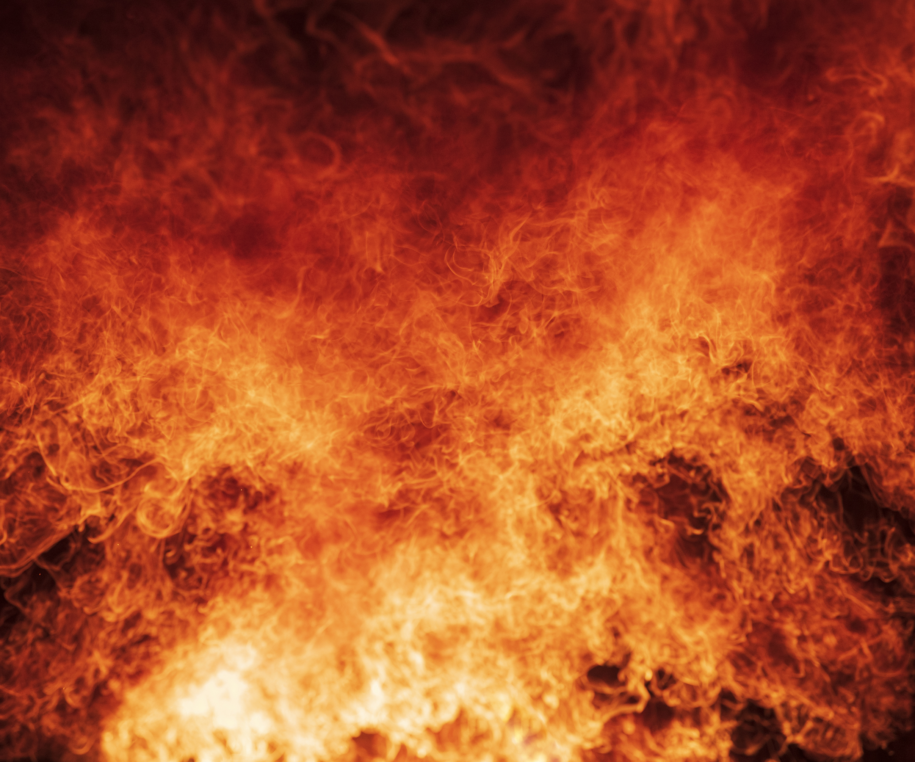
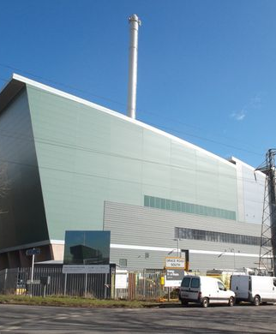
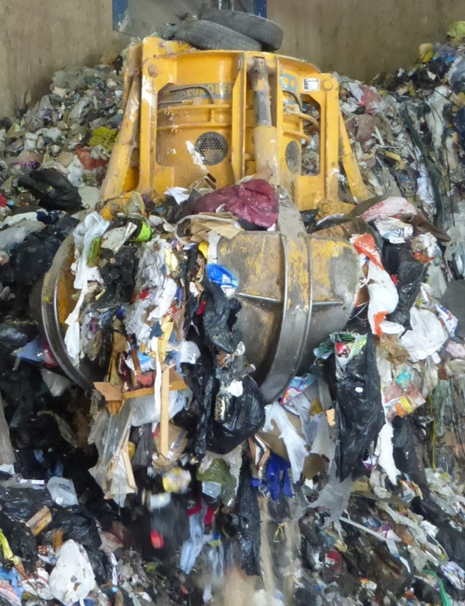
Rubbish
Not sent to landfill in Devon any more
Better for the environment now
Burnt in incinerators in Plymouth & Exeter
Emissions cleaned of pollutants and released into the atmosphere
Produces carbon dioxide gas – contributing to climate change

Slide 7
Do your bit for the environment...... Pack a zero waste lunch!
Q: What is a zero waste lunch?
A: A lunch which contains no throw away packaging or food
Yes please.... | No thanks....
Reusable strong/durable lunch container | Single use paper or plastic bags
Refillable drinks bottle or thermos flask | Single use or non-recyclable containers or drinks cartons
Reusable boxes and containers | Disposable plastic wrap, foil or polystyrene
Washable cloth napkins | Paper napkins
Cutlery to wash and reuse | Plastic ‘disposable’ cutlery

Slide 8
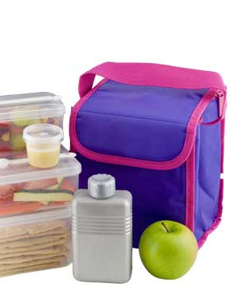
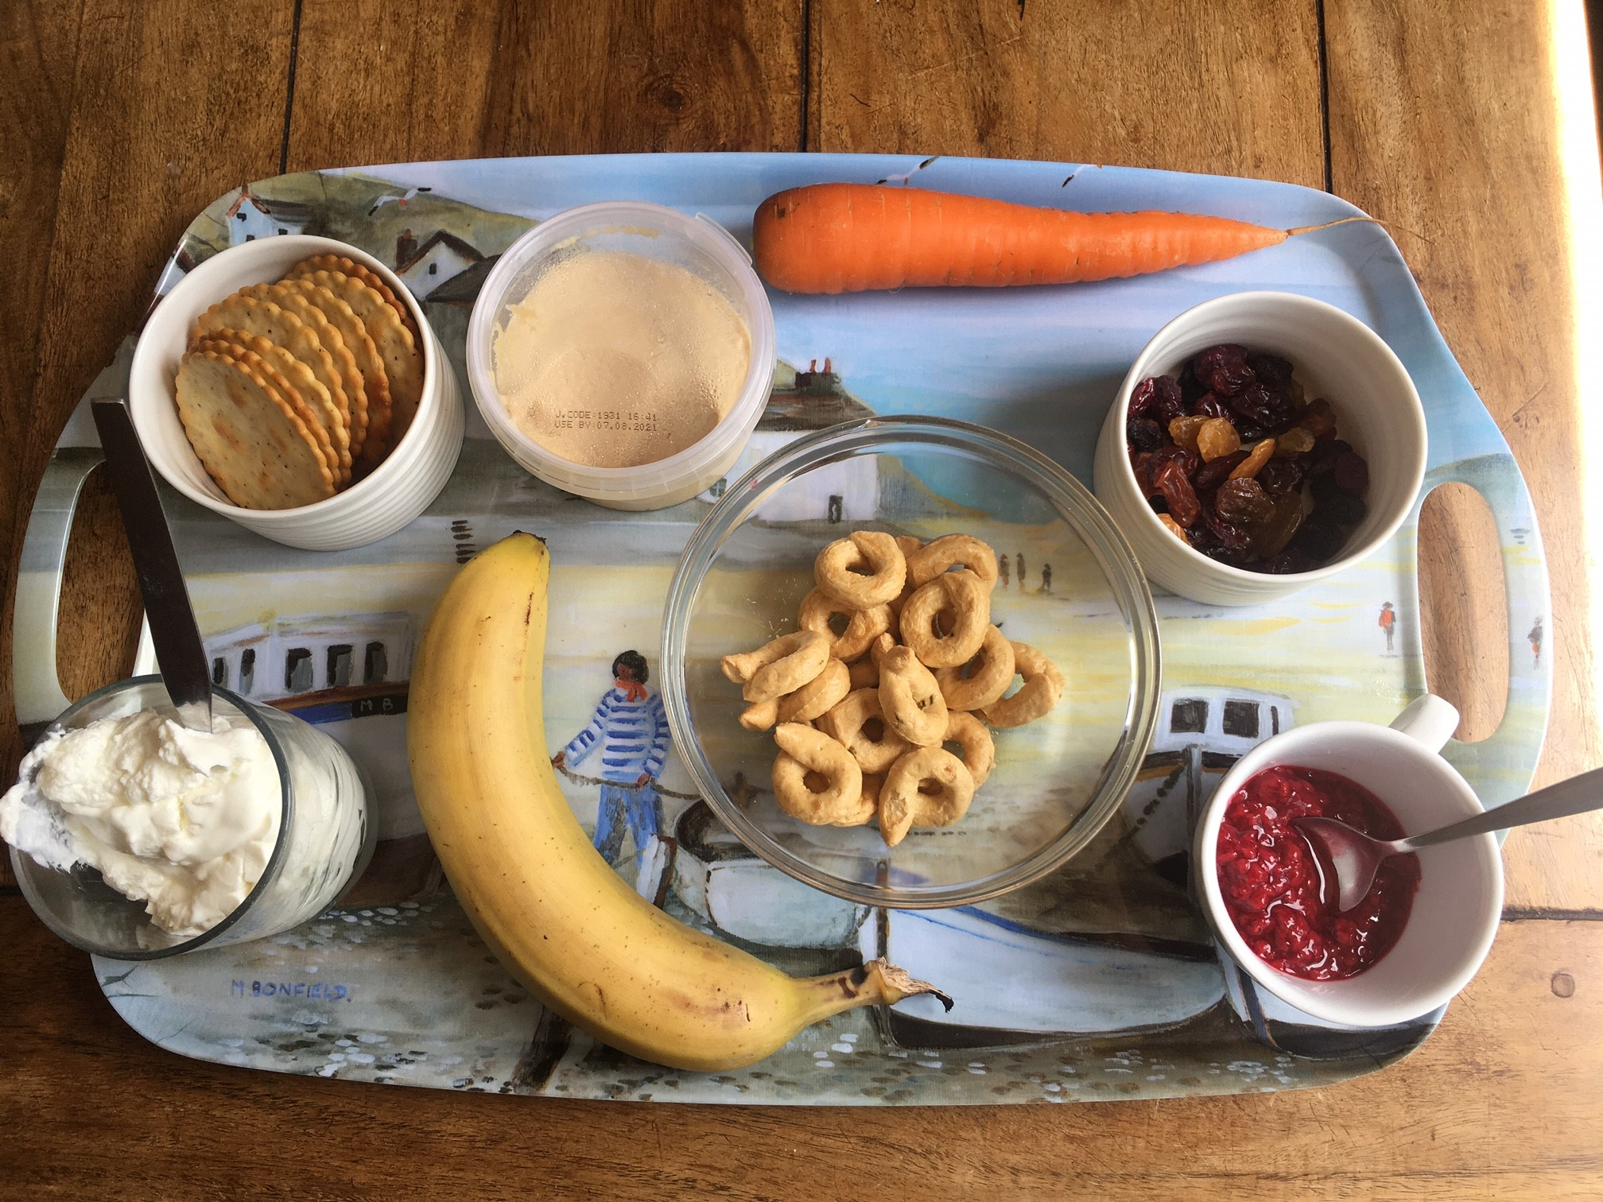
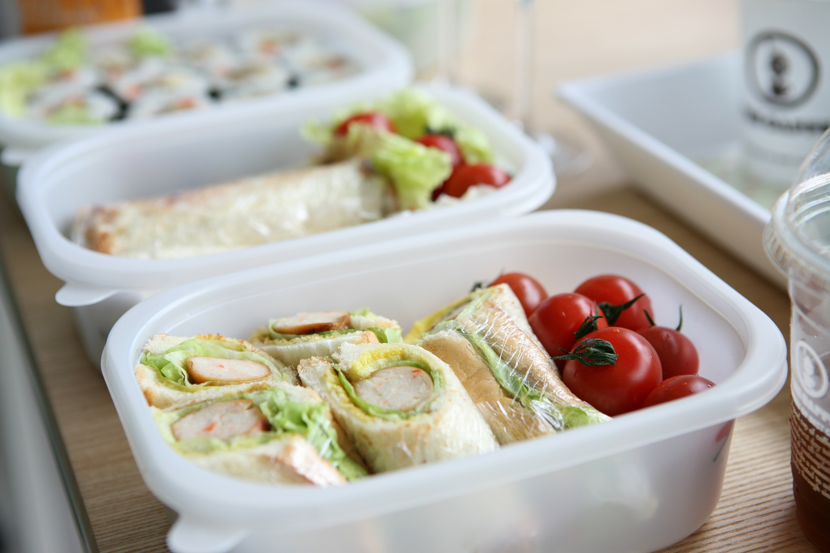
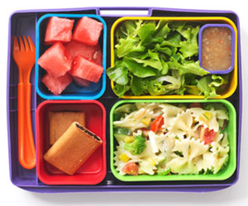
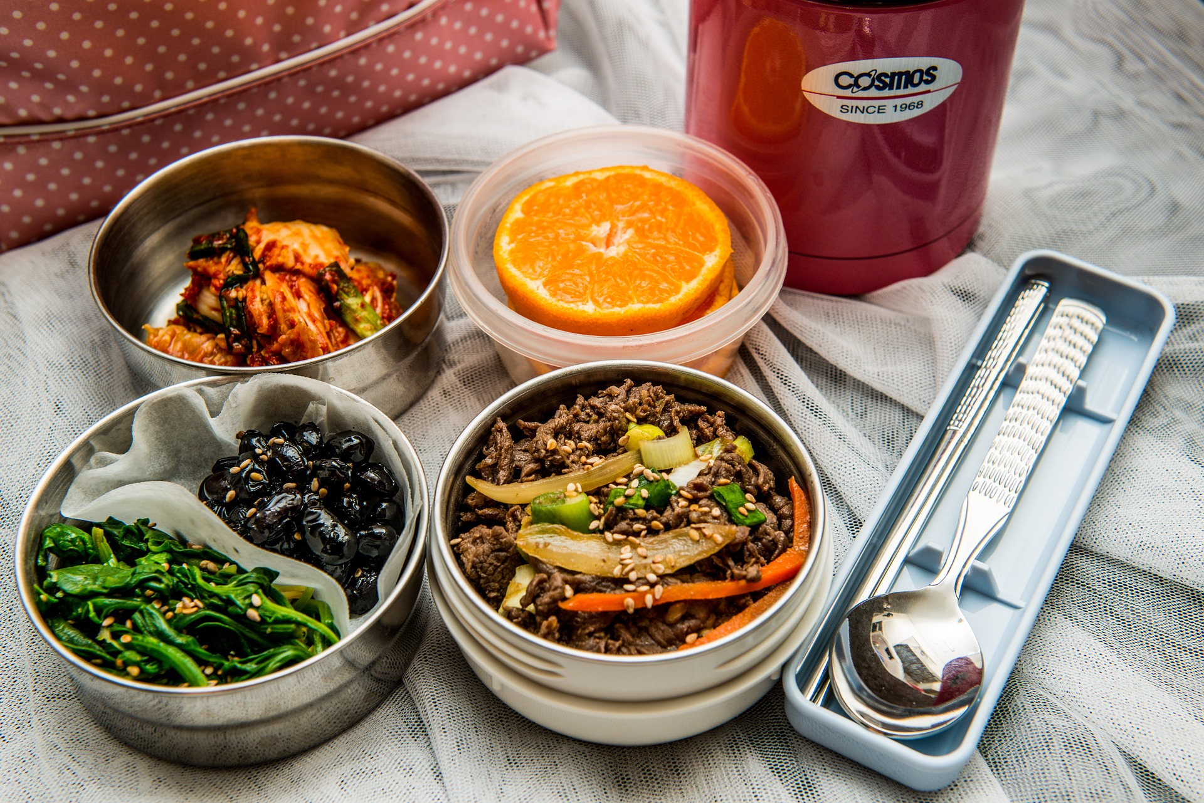
What does a zero waste lunch look like?
Fresh sandwich or wrap
Cold pasta salad
Raw vegetables and hummus dip
Cherry tomatoes
Fresh fruit
Salad
Crackers
Bread sticks
Piece of quiche
Lentils
Couscous

