Slide 1
Litter Pack
Lesson 1: What is litter

Slide 2
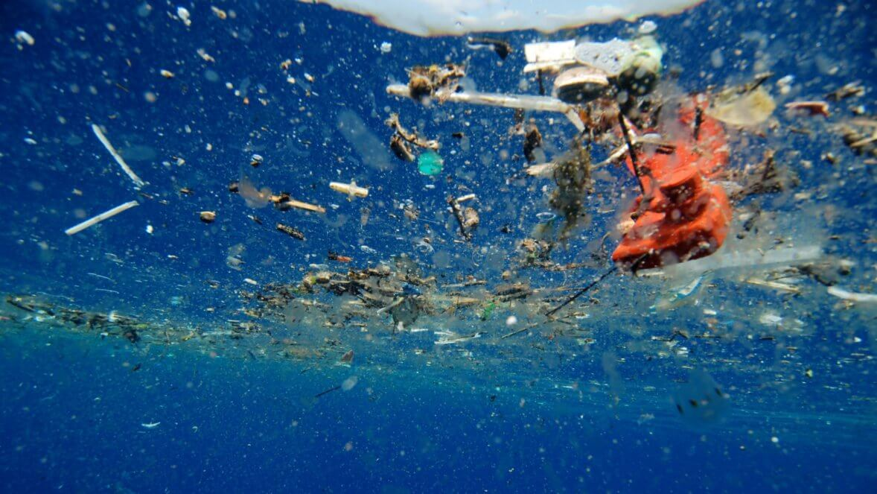
What do you think?
This Photo by Unknown Author is licensed under CC BY-SA

Slide 3
Turtle eating plastic
This turtle thinks that the plastic bag is a jellyfish.
Why?
What do you think will happen to the turtle?

Slide 4
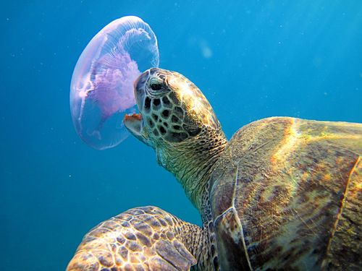

Slide 5
Animals can easily get trapped in litter. Both these creatures were saved, but many will die.

Slide 6
Facts about litter
23 million pieces of litter are dropped each day in the UK.
Over 5000 animals are hurt by litter in Britain each year.
If there wasn’t any litter then the money it takes to clear it up could fund 60,000 new nurses or teachers.
Plastic litter never disappears – it just breaks in to smaller and smaller pieces.

Slide 7
What can we do?
Discuss what we could do in our local area….

Slide 8
What should we be doing?
Reducing our waste!
Reusing items where possible!
Recycling our waste!
Putting non-recyclable waste in litter bins
Taking our litter home to recycle
Why not challenge yourself to have a waste free lunch or waste free picnic next time you go out?

Slide 9
What should councils be doing?
Picking up waste from our homes
Providing recycling bins in towns and cities
Cleaning up litter
Let your local council know if they are not doing these well enough.

Slide 10
Litter quiz
Let’s look at some litter facts, then we’ll answer some questions!
Study the next slide carefully.

Slide 11
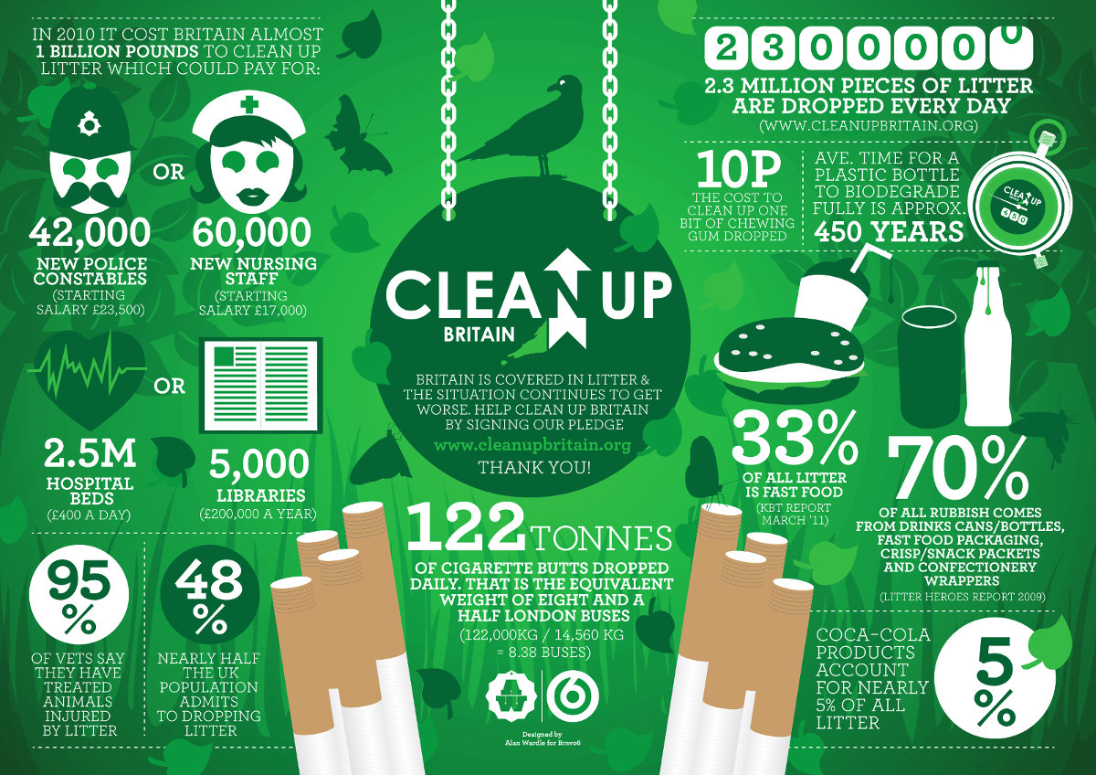
Notes:
Now open up the Litter Quiz Powerpoint to see how much your students can remember…

Slide 12
Open up Litter Quiz Powerpoint

Slide 13
What have you learnt today?
What litter is
Where litter might come from
Some litter facts
What we can do to help

