Slide 1
Litter Pack Lesson 5: The great ocean plastic problem
KS2 Science/Geography

Slide 5
Plastic Litter in our oceans
Using your new knowledge about litter and plastics why do you think we have a problem with plastic in our oceans
Discuss with a partner
Now share with the class

Slide 6
Why?
Plastic stays in the environment – almost all the plastic ever produced is still in the environment as it takes so long to break down.
We produce a lot of it – 300 million tons every year – that’s 42kg for every person on Earth every single year!
It is estimated that half of the plastic we use is used once then thrown away.
Many countries in the world have no waste collection systems – they have no choice but to throw it into their environment.
Plastic is light and floats, so it is washed by rain into rivers.
All water ends up in seas, rivers flow into the sea.
Notes:
Figure from Plastics Europe 2012 - quoted in Eriksen et al (http://journals.plos.org/plosone/article?id=10.1371/journal.pone.0111913)

Slide 7
Ocean gyres
Ocean gyres are massive ocean currents that circulate water and nutrients through the oceans.
They are responsible for a huge amount of life on Earth, by providing nutrients, oxygen and warmth to many animals.
Wind (caused by the rotation of the Earth) moves surface water around the globe, while deeper currents are created by differences in saltiness and temperature of different oceans.
They keep British beaches warm in summer and mild in winter through the Gulf Stream.
Notes:
From NOAA (https://oceanexplorer.noaa.gov/edu/curriculum/section3.pdf): “Surface currents are generated largely by wind. Their patterns are determined by wind direction, Coriolis forces from the Earth’s rotation, and the position of landforms that interact with the currents. Surface wind-driven currents generate upwelling currents in conjunction with landforms, creating deepwater currents.
Currents may also be generated by density differences in water masses caused by temperature and salinity variations. These currents move water masses through the deep ocean—taking nutrients, oxygen and temperature with them.”

Slide 8
The Five Ocean Gyres

Slide 9
Plastic islands
Plastic is swept down rivers in countries with poor waste collection systems and ends up in the sea.
Some falls from container ships and other boats.
Plastic floats in water.
The ocean gyres trap the plastic and massive plastic islands are formed.
The plastic can be tiny pieces (microplastics) or huge pieces.
The plastic islands are now massive - but there is almost 4x that amount on the ocean bed.
Research in 2014 worked out that 5.25 trillion particles of “plastic smog” surface pollution (269,000 tons) pollute our oceans worldwide.

Slide 10
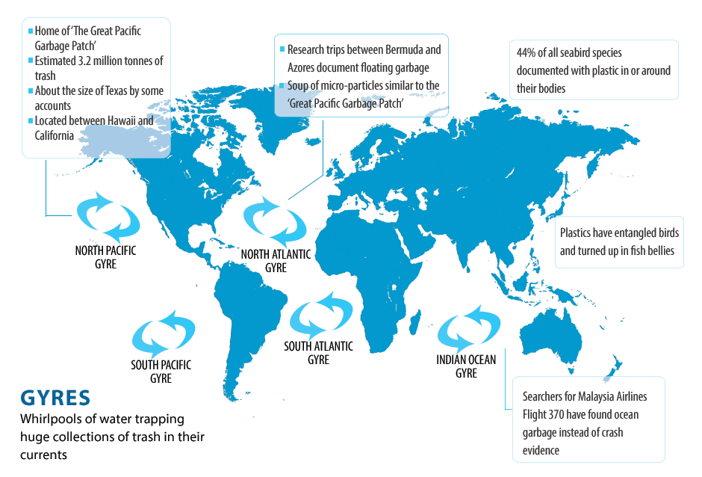
http://www.cbc.ca/news2/interactives/ocean-garbage/

Slide 11
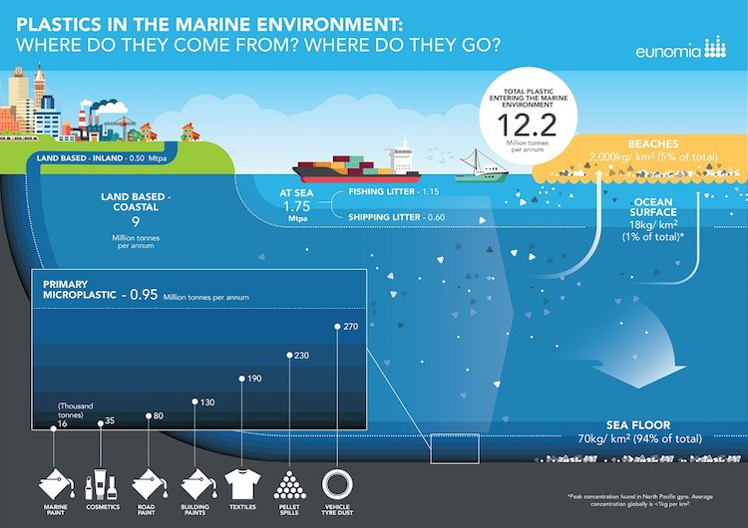

Slide 12
microplastics
Plastics break up into lots of tiny little pieces called microplastics.
People have found them all over the world, in the frozen North Pole and Antarctica, in fish, birds, mammals, even us.
We don’t know how these may affect us in the future.
https://oceanservice.noaa.gov/facts/microplastics.html
Research in Devon is helping us find out more about the problem:
https://www.plymouth.ac.uk/news/pr-features/microplastics-in-the-ocean

Slide 13
What is happening to help solve this problem?
Reducing plastic pollution on the land
https://www.youtube.com/watch?v=mT4Qbp89nIQ https://www.plasticbank.org/
Cleaning up the ocean plastics
https://www.youtube.com/watch?v=PuNXZvdVJg4 https://www.theoceancleanup.com/
Waste charities like Wasteaid providing help to developing countries
https://wasteaid.org.uk/
Research into plastic eating bacteria or other creatures
https://www.theguardian.com/environment/2016/mar/10/could-a-new-plastic-eating-bacteria-help-combat-this-pollution-scourge https://www.theguardian.com/science/2017/apr/24/plastic-munching-worms-could-help-wage-war-on-waste-galleria-mellonella

Slide 14
What can we do?
Tell people about the problem – parents, teachers, everyone!
Reduce our own use of plastic – take part in plastic free schools or communities. Become a Refill School.
Reuse things where possible, mend stuff rather than throwing it away.
Recycle all our plastic. Check with your local District Council.
Take part in litter picks or beach cleans. Organise one yourselves!

