Slide 1
Litter Pack
Lesson 2: Creating art from litter

Slide 2
Can litter be art?
Many great artists have created art from discarded or “found” objects:
Jean Miro
Picasso
Salvador Dali
Kurt Schwitters
There are many local artists who reuse objects including:
Jane Perkins
James Lake
Notes:
Jane Perkins – art from found objects - website: http://www.bluebowerbird.co.uk/info.htm. Can be booked to visit schools,
James Lake – creates sculptures from cardboard – website: http://jameslakesculpture.co.uk/. Visits schools.

Slide 3
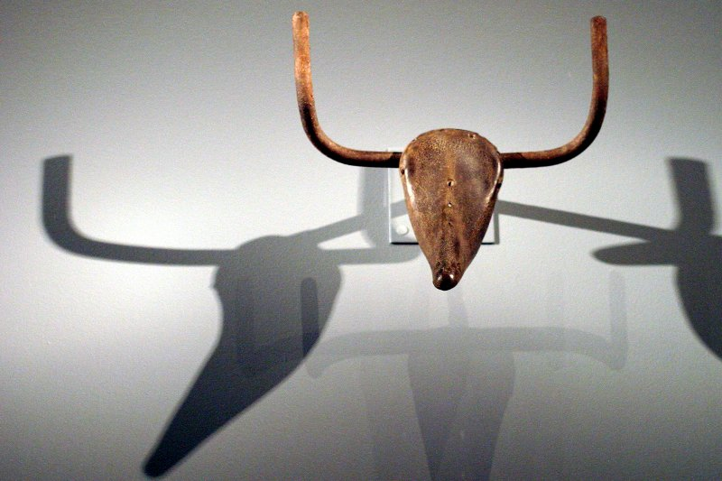
Pablo Picasso, 1942,
Tête de taureau (Bull's Head),
bicycle seat and handlebars, 33.5 x 43.5 x 19 cm,
Musée Picasso, Paris

Slide 4
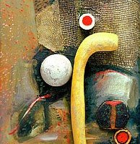
Kurt Schwitters, 1940
Fredlyst with yellow artificial bone
Collage
Sprengel Museum, Hannover

Slide 5
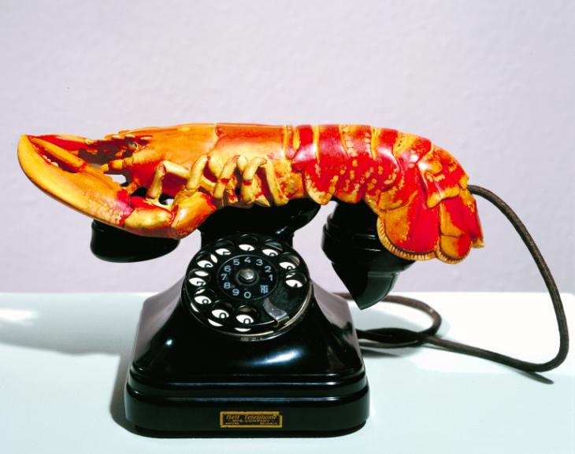
Salvador Dali, 1936
Lobster telephone
Steel, plaster, rubber, resin and paper
178 x 330 x 178 mm
Tate, London

Slide 6
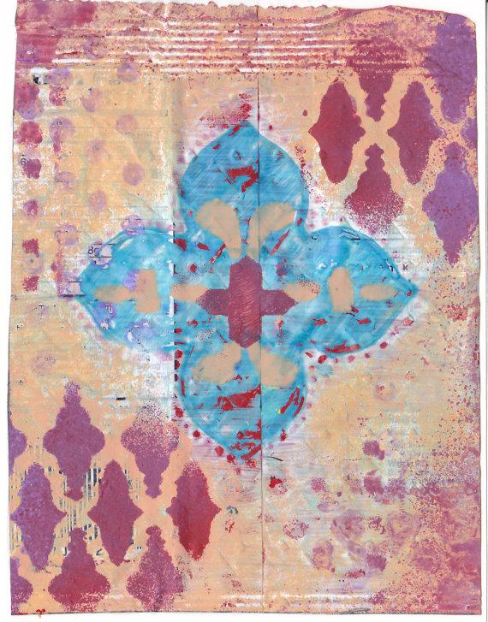
Anon, 2018
Handmade Greeting Card upcycled from Cheez-it packaging litter.
Acrylic & crisp packaging
Museum of Litter, Etsy (online)

Slide 7
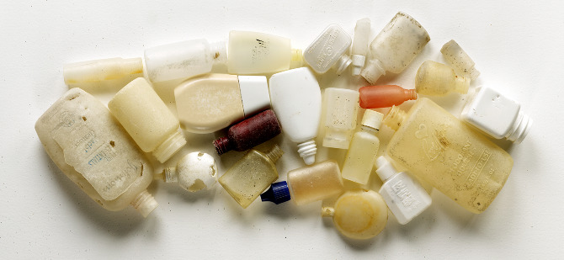
Richard Lang and Judith Selby Lang, 2008
Bottles (horizontal)
Beach litter
15.5" x 33.5"

Slide 8
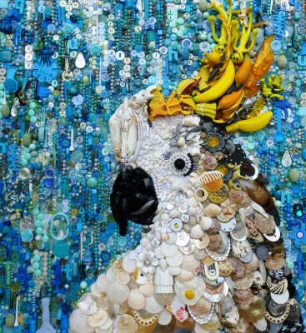
Jane Perkins, 2010
Cockatoo
Assorted plastic waste
74cm x 69cm

Slide 9
What would you do?
Think about what you would like to create …………
Collect your resources:
Paper,
Glue,
Litter (this has been washed and checked for sharp edges)
Now – go and create your work of art!

Slide 10
Plenary
Look at your art – be your own art critic…..
What could you have done better?
Are you pleased with how it has turned out?
Would you like to display it in our classroom art gallery?

